Slide 1
TEAM-C PYTHON PRESENTATION
Shaik Abdul Aleem
Chandralekha M
Afreen Abdul Rawoof
Anish D Souza

Slide 2


Slide 3


Presentation 1 History, Introduction And Features Of Python

Slide 4
HISTORY OF PYTHON
Python is a widely used general-purpose, high-level programming language.
Python was designed by Guido Van Rossum and developed by Python Software Foundation.
It was created in the year 1989.
It got released in the year 1991.

Slide 5
INTRODUCTION
Python is a programming language as well as scripting language.
Python is a object oriented programming language which is surrounded by its function.
Python is widely used as high level language which is mainly understood by humans.
Python is a interpreter language. we have 2 translators
Compiler &
Interpreter
Compiler: Program that converts instructions into a machine-code or lower-level form so that they can be read and executed by a computer.
Interpreter: Program that can analyse and execute a program line by line.

Slide 6
Python supports dynamic memory allocation, where we initialize the value, immediately in the next line icon reassign the value or change.
Dynamic memory allocation:
a = 10
a
10
a = 20
a
20
a = 30
a
30

Slide 7
FEATURES OF PYTHON
It is easy to learn, write and understand the language.
It is free and open source.
It supports cross platform such as different OS like Windows, Mac, Linux, Ubuntu and Unix.
It is dynamic type casted language.
It has a readable syntax.

Slide 8
Presentation 2 Python compilation Identifier Keywords

Slide 9
How compilation happens in python?
Compiler
(C - Python)
Byte code (Low level language)
0 1
Source
Py.
Byte code
binary code
Interpreter
(PVM)
Required Output
O/P

Slide 10
The source code has to be saved with an extension of .py format.
This file is fed as input to the compiler where compiler checks for the syntax and converts it into byte code.
This byte code is again fed as input to the interpreter and with the help of Python Virtual Machine (PVM) it gives us the required output.
This is how compilation happens in python.
Compilation in python happens internally.

Slide 11
IDENTIFIER
It is used to define a function, class, module, object.
Which means if we assign some value to an programmable entity then it is technically called as a identifier.
To check an identifier is valid or not
syntax: ‘string'.isidentifier
There are different rules to create identifier.

Slide 12
Rule 1
Identifier name should start with either alphabets or under score( _ )
abc = 56
‘abc’.isidentifer( )
True
abc_ = 5678
‘abc_’.isidentifier( )
True
_ = 56
‘_’.isidentifier( )
True

Slide 13
Rule 2
It can contain alpha numerical but should not start with numbers.
abc123 = 1256
‘abc123’.isidentifier( )
True
_1235 = 5636
‘_1235’.isidentifier( )
True
1235ab = 5654
‘1235ab’.isidentifier( )
False

Slide 14
Rule 3
Special characters such as !@#$%^&* are not allowed to be an identifier except underscore _
abc! = 1234
‘abc!’.isidentifier( )
False
@#%^ = 1234
‘@#%^’.isidentifier( )
False
_bnm = 1234
‘_bnm’.isidentifier( )
True

Slide 15
Rule 4
As per python doc we can have identifier with unlimited length but maximum 79.
abcdefghijklmnopqrstuvwxyz = 1234
‘abcdefghijklmnopqrstuvwxyz’.isidentifier( )
True
abc = 1234
‘abc’.identifier( )
True

Slide 16
Rule 4
PEP8 is Python enhancement proposal
It is a document that provides guidelines to write a code, if we don’t follow it doesn’t throw any error.
abc = 156
‘abc’.isidentifier( )
156
@ = 156
‘@’.isidentifier( )
syntaxError (False)
ab cd ef = 156
‘ab cd ef’.isidentifier( )
False

Slide 17
KEYWORDS
It has a special words which are reserved and have special meaning.
In python keywords are case sensitive.
As of python 3.10 we have 35 keywords
If we want to get all the keywords, we use
help(‘keywords’)
or
import keyword
keyword.kwlist

Slide 18
Here is a list of the Python keywords. Enter any keyword to get more help.
False class from or
None continue global pass
True def if raise
and del import return
as elif in try
assert else is while
async except lambda with
await finally nonlocal yield
break for not

Slide 19
To check the string is keyword or not
syntax: import keyword
keyword.iskeyword(‘string’)
output will be either True or False
Special keywords: True, False, None
Import keyword
Keyword.iskeyword(‘for’)
True
Keyword.iskeyword(‘None’)
True
Keyword.iskeyword(‘none’)
False

Slide 20
We cannot assign any values to keywords
for = 123
SyntaxError
None = 123
SyntaxError
globe = 123
SyntaxError
yield = 123
SyntaxError
while = 123
SyntaxError

Slide 21
Presentation 3 Variables Memory location

Slide 22
VARIABLES
A variable is a named memory location which is used to store some values or data and can be changed whenever we required
It is name given to a memory location
A variable can hold object of different datatypes
All variables should be in lower case
If there are more than one word in variable then we use underscore to separate them
a = 3569 c = 4+5j
a c
3569 (4+5j)
b = 12.63 d = ‘python’
b d
12.63 ‘python’

Slide 23
Rules to create variables
Rule 1
We should start variables name with an alphabets or underscore
a = 1234 _abd = 114
a _abd
1234 114
acd = 12356
acd
12356
_ = 786
_
786

Slide 24
Rule 2
A variable can contain only A-Z, a-z, 0-9, _
acd123 = 5555 _acd123 = 3333
acd123 _acd123
5555 3333
ACD123 = 6666
ACD
6666
_acd = 4444
_acd
4444

Slide 25
Rule 3
We cannot start variable name with numbers
123 = 3333
123
syntax error
12bbb = 4444
12bbb
syntax error
abc123 = 2
abc123
2

Slide 26
Rule 4
We cannot have special characters with variable names !@#$%^&*
ab! = 6
syntax error
abc = 5
syntax error
ab c = 5
syntax error
ab_c = 5
ab_c
5

Slide 27
Rule 5
Variables are case sensitive which means upper case characters are different and lower case characters are different
mmm = 111
MMM = 222
mmm
111
MMM
222

Slide 28
Rule 6
Do not use reverse keyword as an variable name
for = 2222
syntax error
if = 1111
syntax error
while = 3333
syntax error
yield = 6666
syntax error

Slide 29
MEMORY LOCATION
If we want to find memory address or location of an value we use id( )
a = a = 56
syntax error b = 47
a = 1 c = 47
id(a) id(a)
1483836293360 2522407438288
b = 1 id(b)
id(b) 2500407438000
1483836293360 id(c)
c = 2 2500407438000
id(c)
1483836293392

Slide 30
Presentation 4 Memory management Datatypes

Slide 31
MEMORY MANAGEMENT IN VARIABLES
RAM is also called as Random Access Memory
Is essentially a piece of hardware that stores your computer's short-term memory while the computer is running.
RAM contains of 2 parts
Stack
Heap
Stack is used to store variables in organized manner
Heap is used to store values or objects in randomly
Mainframe is used for execution

Slide 32
RAM
STACK
HEAP
10
20
MAINFRAME a
b
c
40

Slide 33
Variables starts pointing towards respective values or objects and the reference count of each value will be 1
Python supports dynamic memory allocation
We can change the value for variables whenever we required
We will difference 10 from variable ‘a’ and start pointing towards ‘b’
The reference count of 20 becomes 2 and 10 becomes 0 because no variables pointing towards 10
When the reference count becomes 0 the garbage collection comes into picture and removes the value from memory and free up the space
This is how memory management happens in variables

Slide 34
DATA TYPES
Container tells us what kind of data is stored
Data types represents the type of data stored in a memory location
Variables can hold values and every value has a data type
Python is a dynamic type language, hence we do not need to define the type of data while declaring it
If we want to find the data type of value we use type( )
In python data types has been classified into 2 types
Individual datatypes / single value datatypes
collection datatypes / container datatypes

Slide 35
Python Data types
Individual data types collection data types
1. Integer → int 1. string → str
2. Float → float 2. list → list
3. Complex → complex 3. tuple → tuple
4. Boolean → bool 4. set → set
5. dictionary → dict

Slide 36
Presentation 5 Individual datatypes Operations done on Integer Operations done on Float

Slide 37
Individual datatypes
It specifies the data stored inside the memory location to be an integer
Integers can be positive or negative
a = 10 d = 023
type(a) type(d)
<class ‘int’> syntaxerror
b = 20 c = -30
type(b) type(c)
<class’int’> <class’int’>

Slide 38
1. Operations Done On Integer
FIRST WAY → By using variables Second way → By using Int( )
a = 20 a = int(20)
a a
20 20
b = 30 b = int(30)
b b
30 30
c = 60 c = int(60)
c c
60 60

Slide 39
If we want to get the attributes/functions/methods of any datatypes/class we use dir( )
dir(int)
['__abs__', '__add__', '__and__', '__bool__', '__ceil__', '__class__', '__delattr__', '__dir__', '__divmod__', '__doc__', '__eq__', '__float__', '__floor__', '__floordiv__', '__format__', '__ge__', '__getattribute__', '__getnewargs__', '__gt__', '__hash__', '__index__', '__init__', '__init_subclass__', '__int__', '__invert__', '__le__', '__lshift__', '__lt__', '__mod__', '__mul__', '__ne__', '__neg__', '__new__', '__or__', '__pos__', '__pow__', '__radd__', '__rand__', '__rdivmod__', '__reduce__', '__reduce_ex__', '__repr__', '__rfloordiv__', '__rlshift__', '__rmod__', '__rmul__', '__ror__', '__round__', '__rpow__', '__rrshift__', '__rshift__', '__rsub__', '__rtruediv__', '__rxor__', '__setattr__', '__sizeof__', '__str__', '__sub__', '__subclasshook__', '__truediv__', '__trunc__', '__xor__', 'as_integer_ratio', 'bit_count', 'bit_length', 'conjugate', 'denominator', 'from_bytes', 'imag', 'numerator', 'real', 'to_bytes']

Slide 40
If we want to convert –ve integer into Default value of integer → 0, int( ) +ve integer we use abs( ) → absolute
a = -30 a = 0
abs(a) type(a)
30 <class’int’>
b = -100 b = int( )
abs(b) type(b)
100 <class’int’>
c = -2365
abs(c)
2365

Slide 41
Operations done on integers
Addition +
Subtraction –
Multiplication *
Division /
Modulus %
Exponent → raise of the power **

Slide 42
Addition (+) Subtraction(-)
4+6 7-4
10 3
5+5 100-50
10 50
6+6 30-10
12 20
10+10 200-100
20 100
100+0100 30-20
syntax error 10

Slide 43
Multiplication(*) Division(/)
2*2 100/50
4 2
5*5 2/2
25 0
6*6 10/2
86 5
5*2 20/10
10 2

Slide 44
Floor division(//) modulus(%) If we want to get only quotient if we want to get reminder
45//9 45%9
5 0
34//3 34%1
11 1
67//2 67%2
33 1
23//3 56%3
7 2

Slide 45
Divmod( ) Exponent(**)
if we want to get both quotient and reminder
a = divmod(56,7) 2**2
a 4
(8,0) 25**2
b = divmod(25,3) 625
b 3**4
(8,1) 81
c = divmod(256,3) 5**5
c 3125
(85,1)

Slide 46
Presentation 6 Individual datatypes Operations done on Float

Slide 47
2. Operation done on float data type
It specifies data stored inside a memory location is of type decimals
float( ) datatype
We can have both +ve and –ve floats numbers
a = 45.23 c = -123.456
type(a) type(c)
<class’float’> <class’float’>
b = 2253.36
type(b)
<class’float’>

Slide 48
Ways to create float numbers
By associating values in a variables
By using float( ) → float( ) constructor
a = float(10.3)
type(a)
<class’float’>
Default values of float numbers
0.0
a = 0.0 b = float( )
type(a) type(b)
<class’float’> <class’float’>

Slide 49
If we want to get the attributes/functions/methods of any datatypes/class we use dir( )
Dir(float)
['__abs__', '__add__', '__bool__', '__ceil__', '__class__', '__delattr__', '__dir__', '__divmod__', '__doc__', '__eq__', '__float__', '__floor__', '__floordiv__', '__format__', '__ge__', '__getattribute__', '__getformat__', '__getnewargs__', '__gt__', '__hash__', '__init__', '__init_subclass__', '__int__', '__le__', '__lt__', '__mod__', '__mul__', '__ne__', '__neg__', '__new__', '__pos__', '__pow__', '__radd__', '__rdivmod__', '__reduce__', '__reduce_ex__', '__repr__', '__rfloordiv__', '__rmod__', '__rmul__', '__round__', '__rpow__', '__rsub__', '__rtruediv__', '__setattr__', '__setformat__', '__sizeof__', '__str__', '__sub__', '__subclasshook__', '__truediv__', '__trunc__', 'as_integer_ratio', 'conjugate', 'fromhex', 'hex', 'imag', 'is_integer', 'real']

Slide 50
If we want to get +ve value of a float number which is in –ve we use → abs( )
a = -25.25
abs(a)
25.25
Operations done on float numbers
Addition +
Subtraction –
Multiplication *
Division /
Floor division //
Modulus %
Divmode( )
Exponent **

Slide 51
Addition (+) Subtraction(-)
a = 78.456 a = 78.456
b = 87.98 b = 87.98
a+b a - b
166.436 -9.524000001
c = 45.654 c = 46.9897
d = 10.091 d = 2.567890
c + d c - d
55.747 44.42181

Slide 52
Multiplication(*) Division(/)
a = 3.45 a = 34.45
b = 2.54 b = 7.5
a * b a / b
8.763 4.593333334
c = 9.98765 c = 60.5
d = 4.45 d = 4.5
c * d c / d
44.4450425000001 12.4444444445

Slide 53
Floor division(//) modulus(%)
If we want to get only quotient if we want to get reminder
a = 9.65 a = 9.65
b = 3.56 b = 3.56
a // b a % b
2.0 2.530000002
c = 34.0 c = 34.0
d = 2.0 d = 2.0
c // d c // d d // c
0.0 0.0 2.0

Slide 54
Divmod( ) Exponent(**)
if we want to get both quotient and reminder
a = 9.65 a = 2.45 ** 2
b = 3.56 a
d = divmod(a,b) 6.0025000001
(2.0,2.5300000002)
c = 81.23 b = 4.5 ** 2.5
d = 9.23 b
d1 = divmod(c,d) 42.956736957082 (8.0,7.3900001)

Slide 55
Round( )
It rounds off to the nearest number based on digit
If the decimal digit is greater than 0.5 then it will round to next number
If the decimal digit is less than 0.5 it will remain in same number
If the decimal digit is equal to 0.5 then it will round off nearest even number
a = 10.6 c = 10.4 e = 45.5
round(a) round(c) round(e)
11 10 46
b = 15.8 d = 98.234 f = 23.5
round(b) round(d) round(f)
16 98 24

Slide 56
If we want to round( ) limited decimals digits then we use → round(num,precision)
a = 23.34567 c = 56.98765463
round(a,3) round(c,5)
23.346 56.98765
b = 456.45678
round(b,2)
456.46

Slide 57
If we want to remove decimal digit we use → trunc( )
It truncates/ eliminates the decimal point from a floating number
a = 67.89
trunc(a)
name error
If we want to perform trunc( ), first we have to import it from math module
import math
a = 67.89 b = 9876.2356
math.trunc(a) math.trunc(e)
67 9876

Slide 58
Note
If we use trunc( ) in float we will have some data loss and trunc( ) applies only in float datatype
a = 123
math.trunc(a)
123

Slide 59
Presentation 7 Individual datatypes Operations done on Boolean

Slide 60
3. Operations done on Complex
Complex numbers are these which are written in a+bj form and the value of j is → sq root (-1)
Complex number is a combination of both real part and imaginary part. They have equal importance
Complex number can be both +ve and –ve
a = 5+5j
type(a)
<class’complex’>
a = -4+5j
type(a)
<class’complex’>

Slide 61
Ways to create complex numbers
By using variables
By using complex( ) → complex constructor
a = 7j-8 another way using complex( )
a a = complex(3, 6)
(-8+7j) a
(3+6j)
a = complex(5+6j)
a
(5+6j)

Slide 62
If we want to get the attributes/functions/methods of any datatypes/class we use dir( )
Dir(complex)
['__abs__', '__add__', '__bool__', '__class__', '__delattr__', '__dir__', '__doc__', '__eq__', '__format__', '__ge__', '__getattribute__', '__getnewargs__', '__gt__', '__hash__', '__init__', '__init_subclass__', '__le__', '__lt__', '__mul__', '__ne__', '__neg__', '__new__', '__pos__', '__pow__', '__radd__', '__reduce__', '__reduce_ex__', '__repr__', '__rmul__', '__rpow__', '__rsub__', '__rtruediv__', '__setattr__', '__sizeof__', '__str__', '__sub__', '__subclasshook__', '__truediv__', 'conjugate', 'imag', 'real']
Note: the methods which starts with (__) is called as magic methods or special method or dunder methods → dunder stands for double underscore

Slide 63
Operations done on Complex numbers
Addition +
Subtraction –
Multiplication *
Division /
Floor division //
Modulus %
Divmode( )
Exponent **

Slide 64
Addition Subtraction
a = 3 + 6j a = 34 – 2j
b = 3 + 2j b = 20 + 2j
a + b a - b
(6 + 8j) (14 – 4j)
Multiplication Division
a = 3 + 5j a = 2 + 0j
b = 2 + 3j b = 12 + 3j
a * b a / b
(-9 + 19j) (0.156862 – 0.039215636274j)

Slide 65
Floor division Modules
a = 3 + 2j a = 3 + 2j
b = 2 + 3j b = 2 + 3j
a // b a % b
TypeError: Unsupported operant TypeError:
type(s) for // : ‘complex’ and ‘complex’
Divmod( ) Exponent
a = 3 + 2j a = 2 + 3j
b = 2 + 3j b = a ** 2 +3j
d = divmod(a,b) b
TypError: (-5 + 15j)

Slide 66
Presentation 8 Individual datatypes Operations done on Boolean

Slide 67
4. Operations done on Boolean
Its useful in condition expression
Boolean variables are defined by the True and False keywords
The value for True is → 1
The value for False is → 0
For default values boolean will return False
For non-default values boolean will return True
Default values for boolean is → False

Slide 68
For all default values
Int
a = 0 b = int( )
bool(a) bool(b)
False False
Float
a = 0.0 b = float( )
bool(a) bool(b)
False False
Complex
a = 0 + 0j a = complex( )
bool(a) bool(a)
False False

Slide 69
For all non-default values
Int
a = 10 b = int(10)
bool(a) bool(b)
True True
Float
a = 10.076 b = float(3.6)
bool(a) bool(b)
True True
Complex
a = 4 + 3j b = complex(2 + 4j)
bool(a) bool(b)
True True

Slide 70
Isinstance
It returns True if the specified data matches with specified data type, or else it returns False.
Syntax: isinstance(data, (data types))
isinstance(5, int) isinstance(5, float)
True False
isinstance(10,(int, float, bool)) isinstance(4 + 3j(int, float, bool))
True False
isinstance(2.6(int, float, complex))
True

Slide 71
Presentation 9 Collection Data Types String Management in String

Slide 72
Collection Data Types
1. String
A string is a collection of characters or set of characters or group of characters which is enclosed within quotes or which lies in quotes is called as string
s = “python”
type(s)
<class’str’>
s = ‘123’
type(s)
<class’str’>

Slide 73
Ways to create a string with different quotes
1. Single quote 2. Double quote
s = ‘puthon’ s = “python”
type(s) type(s)
<class’str’> <class’str’>
s = ‘python@class_qspiders’ s = “python@class_qspiders”
type(s) type(s)
<class’str’> <class’str’>
3. Triple quotes
s = “’python@class_qspiders”’
type(s)
<class’str’>

Slide 74
When to go for single and double quotes
s = ‘aulleem and chandralekha belongs to team c
syntax error:
s = ‘aulleem and chandralekha belongs to team c”
syntax error:
When ever we have a single quotes in a sentence we have to enclose the boundary with in double quotes
s = “could’t attend the python class”
When ever we have double quotes in a sentence we have to enclose the boundary with single quote
s = ‘The palace is named as “Mysore palace”’
<class’str’>

Slide 75
Ways to create string
‘python’, “python”, “’python”’. “”python””
Boundary: ‘ ’,” ”,”’ ”’, “”
String is called a immutable data types → modified can’t be done
When ever we want to find the total no. of characters present in string we use → len( )
s = ‘I did my masters in Automobile engineering’
len(s)
42
s = “I failed to be successful engineer”
len(s)
34

Slide 76
If we want to get the attributes/functions/methods of any data types/class we use dir( )
Dir(str)
['__add__', '__class__', '__contains__', '__delattr__', '__dir__', '__doc__', '__eq__', '__format__', '__ge__', '__getattribute__', '__getitem__', '__getnewargs__', '__gt__', '__hash__', '__init__', '__init_subclass__', '__iter__', '__le__', '__len__', '__lt__', '__mod__', '__mul__', '__ne__', '__new__', '__reduce__', '__reduce_ex__', '__repr__', '__rmod__', '__rmul__', '__setattr__', '__sizeof__', '__str__', '__subclasshook__', 'capitalize', 'casefold', 'center', 'count', 'encode', 'endswith', 'expandtabs', 'find', 'format', 'format_map', 'index', 'isalnum', 'isalpha', 'isascii', 'isdecimal', 'isdigit', 'isidentifier', 'islower', 'isnumeric', 'isprintable', 'isspace', 'istitle', 'isupper', 'join', 'ljust', 'lower', 'lstrip', 'maketrans', 'partition', 'removeprefix', 'removesuffix', 'replace', 'rfind', 'rindex', 'rjust', 'rpartition', 'rsplit', 'rstrip', 'split', 'splitlines', 'startswith', 'strip', 'swapcase', 'title', 'translate', 'upper', 'zfill']

Slide 77
Default value of string
a = ‘ ‘ d = str( )
type(a) type(d)
<class’str’> <class’str’>
b = “ ”
type(b)
<class’str’>
c = “’ “’
type(c)
<class’str’>

Slide 78
MANAGEMENT IN STRING
RAM
HEAP
STACK
H
l
e
o
MAINFRAME
S
S
H E L L O

Slide 79
If we want to execute any code RAM is required, RAM has classified into 2 types
Stack
Heap
Stack is used to store variables and it has placed in organized way
Heap is used to store objects or values and it has placed in unorganized way/randomly
Main frame is used for execution
As string is collection of characters, it has been splited into each characters in the heap memory and it will have a memory block which will be pointed by the variable, each characters of string will allocate the respective memory blocks and forms the string. Here, characters in the heap memory are not duplicated
This is how memory management happens in string

Slide 80
Presentation 10 Indexing Slicing +Ve Slicing -Ve Slicing Using +Ve Step Value

Slide 81
INDEXING
The process of extracting single character from a string is called indexing in string
In indexing there are 2 types
+ve indexing (starts from 0)
-ve indexing (starts from -1)
s = ‘hello world’
0 1 2 3 4 5 6 7 8 9 10
h e l l 0 w o r l d
-11 -10 -9 -8 -7 -6 -5 -4 -3 -2 -1

Slide 82
EXAMPLES
S = ‘hello world’
if we want to extract single element we use → Var_name [index position]
Positive indexing Negative indexing
s[3] s[-4]
‘l’ ‘o’
s[7] s[-6]
‘o’ ‘ ‘
s[5] s[-2]
‘ ‘ ‘I’
Notes:
It tells us the position of the character

Slide 83
s1 = ‘Python programming’
Positive indexing Negative indexing
s1[5] s1[-5]
‘n‘ ‘m’
s1[9] s1[-18]
‘r’ ‘p’
s1[13] s1[-1]
‘m’ ‘g’

Slide 84
SLICING
The process of extracting multiple characters simultaneously from a string is called slicing
Syntax: var_name [start index: end index: step value]
Start index: 0 by default
End index: Length of the string by default
Step value: 1 by default
+VE SLICING
s = ‘hello world’
s[0:3:1] s[::1] s[0:11:2]
‘hel’ ‘hello world’ ‘hlowrd’
s[6:9:1] s[:10:3]
‘wor’ ‘hl wl’

Slide 85
HOW +Ve SLICING WORKS
s = ‘hello world’
0 1 2 3 4 5 6 7 8 9 10
h e l l 0 w o r l d
-11 -10 -9 -8 -7 -6 -5 -4 -3 -2 -1
slicing process → start index + step value
s[0:3:1] s[0:11:2] s[6:9:1]
0+1=1 → h 0+2=2→h 6+1=7→w
1+1=2 → he 2+2=4→hl 7+1=8→wo
2+1=3 → hel 4+2=6→hlo 8+1=9→wor
‘hel’ 6+2=8→hlow ‘wor’
8+2=10→hlowr
10+2=12→hlowrd
‘hlowrd’

Slide 86
-VE SLICING With +Ve Step Value
s = ‘hello world’
s[-2:-6:1] s[-8:-4:2]
‘ ’ ‘l ’
s[-8:-3:1] s[-11:-3:2]
‘lo wo’ ‘hlow’
s[-6:-8:3] s[-8::3]
‘ ’ ‘lwl’

Slide 87
HOW -Ve SLICING WORKS
s = ‘hello world’
0 1 2 3 4 5 6 7 8 9 10
h e l l 0 w o r l d
-11 -10 -9 -8 -7 -6 -5 -4 -3 -2 -1
Negative indexing will be converted into +ve indexing by interpretor
slicing process → start index + step value
s[-2:-6:1] s[-8:-4:2] s[-11:-3:2]
-2+1=-1→ -8+2=-6→ l -11+2= -9→h
-1+1= 0→ -6+2= -4→ l -9+2= -7→hl
‘ ’ → empty ‘l ’ -7+2=-5→hlo
‘hlo’

Slide 88
Presentation 11 Slicing -Ve Slicing Using -Ve Step Value Combination Of Both +Ve And –Ve Slicing

Slide 89
-Ve Slicing Using -Ve Step Value
s = ‘hello world’
s[-1: -len(s)-1: -1] or s[::-1]
‘dlrow olleh’ ‘dlrow olleh’
I want to extract ‘row’in –ve slicing I want to extract ‘drwo’
s[-3:-6:-1] s[-1:-8:-2] ‘row’ ‘drwo’
I want to extract ‘wol’
s[-5:-10:-2]
‘wol’

Slide 90
s[-1: -len(s)-1: -1]
-1-1=-2→ d
-2-1=-3→dl
-3-1=-4→dlr
-4-1=-5→dlro
-5-1=-6→dlrow
-6-1=-7→dlrow ’
-7-1=-8→dlrow o
-8-1=-9→dlrow ol
-9-1=-10=dlrow oll
-10-1=-11→dlrow olle
-11-1=-12→dlrow olleh

Slide 91
Combination of both +ve and –ve slicing
s = ‘hello world’
0 1 2 3 4 5 6 7 8 9 10
h e l l 0 w o r l d
-11 -10 -9 -8 -7 -6 -5 -4 -3 -2 -1
s[3:-4:1] s[-7:9:2] s[3:-11:2]
‘lo w’ ‘owr’ ‘le’
s[:2:-1] s[-7:9:-2]
‘dlrow ol’ ‘ ’

Slide 92
Why string is called as immutable data type
Since we cannot modify the original string if we want to do means we have to take the copy of original string and can do modification. Modification includes either adding on characters or removing the characters. This is why is called immutable data type

Slide 93
Presentation 12 String methods: Upper(), Lower(), Swapcase(), Len(), count(), Index(), rindex(), find() & replace()

Slide 94
STRING METHODS
UPPER
Upper( ):
It converts lower case characters into upper case characters
syntax: Var_name.upper( )
s = ‘hello world’ s = ‘python WORLD’
s.upper( ) s.upper()
‘HELLO WORLD’ ‘PYTHON WORLD’

Slide 95
LOWER
Lower( )
It converts upper characters into lower characters
Syntax: Var_name.lower( )
s = ‘HELLO PYTHON’ s = ‘Hi python’
s.lower() s.lower()
‘hello python’ ‘hi python’

Slide 96
SWAPCASE
Swapcase( )
It converts upper case into lower and lower case into upper
Syntax: Var_name.swapcase( )
s = ‘Python World’ s = ‘TeAm InDiA’
s.swapcase( ) s.swapcase( )
‘pYTHON wORLD’ ‘tEaM iNdIa’

Slide 97
LEN
Len( )
It returns total no. of characters present in the string
Syntax: len(Var_name)
s = ‘python world’ s = ‘life is beautiful’
len(s) len(s)
12 17

Slide 98
COUNT
It returns no. of occurrence of a substring in original string
Syntax: Var_name.count(‘substring’, si, ei)
s = ‘python world’ s = ‘python programming’
s.count(‘o’) s.count(‘m’, 3, 18)
2 2
s = ‘life is beautiful’
s.count(‘i’, 7)
1

Slide 99
INDEX
It searches the specified values and it returns the position of where it was found
It raises value error if the substring is not found
Syntax: Var_name.index(‘substring’, si, ei)
s = ‘hello world’ s = ‘hello world’
s.index(‘I’) s.index(‘l’, -7, -1)
2 9
s.index(‘l’, 4,10)
9

Slide 100
RINDEX
rindex( )
It searches for the specified values and it returns the position of where it was found
Syntax: Var_name.rindex(‘substring’, si, ei)
s = ‘hello world’ s = ‘python programming’
s.rindex(‘o’) s.rindex(‘o’, 4, 8)
7 4
s = ‘python programming’
s.rindex(‘o’, 10)
ValueError: String not found

Slide 101
FIND
It searches for the specified value and it returns the position of where it was found
It returns -1 if substring Is not present
Syntax: Var_name.find(‘substring’, si, ei)
s = ‘hello world’
s.find(‘o’)
4
s = ‘hello world’
s.find(‘H’)
-1 To overcome value error we go for find( )

Slide 102
REPLACE
replace( )
It replaces a specified phrase with another specified phrase
Syntax: Var_name.replace(‘old value’, ‘new value’, ‘count’)
s = ‘python programming’
s.replace(‘pro’, ‘PRO’)
‘python PROgramming’
s = ‘hello world’
s.replace(‘world’, ‘python’)
‘hello python’

Slide 103
Presentation 13 String methods: split(), join() & strip() Boolean methods: startswith(), endswith(), isupper(), islower(), isalnum(), isdigit() & isspace()

Slide 104
SPLIT
Split( )
It splits the string at the specified seperator and returns a list
Syntax: Var_name.split(‘seperator’, max split)
s = ‘welcome to python session’
s.split( )
[‘welcome’, ‘to’, ‘python’, ‘session’]
By default split( ) takes whitespace as separator and it splits from left side of the string

Slide 105
MAX SPLIT
s = ‘hey guys good afternoon welcome to python’
s.split(‘ ’, 5)
[‘hey’, ‘guys’, ‘good’, ‘afternoon’, ‘welcome’, ‘to python’]
s.split('o')
['hey guys g', '', 'd aftern', '', 'n welc', 'me t', ' pyth', 'n']
s.split(‘ ’, -2)
[‘hey’, ‘guys’, ‘good’, ‘afternoon’, ‘welcome’, ‘to’, ‘python’]
-1 and -2 is not an valid number so the string splits at the space as seperator

Slide 106
RSPLIT
rsplit( )
It splits the string at the specified separator and returns a list
Synyax: Var_name.rsplit(‘seperator’, max split)
It splits from right side of the string
s = ‘hey guys good afternoon welcome to python class’
s.rsplit(‘ ’, 2)
[‘hey guys welcome to’, ‘python’, ‘class’]

Slide 107
JOIN
Join( )
It joins the elements of an iterable using the string specified
Syntax: ‘string’. Join(iterable)
ITERABLE: All collection data type (string, list, tuple, set, dictionary)
s = ‘hello’ s = ‘hello world’
‘_’. Join(s) ‘hai’. Join([‘hello’, ‘world’)
‘h_e_l_l_o’ ‘hello hai world’

Slide 108
STRIP
Strip( )
It removes any leading and trailing characters in a string
Syntax: Var_name.strip(character)
If you don’t pass any arguments in strip( ) → it will space as default stripping character
s = ‘ hello world ’ s = ‘ hello world ’
s.strip(‘ ’) s.strip( )
‘hello world’ ‘hello world’
s = ‘@#%$^python programme@%’
s.strip(‘#$^%’)
‘@#%$^python programme#@’

Slide 109
LSTRIP
lstrip( )
It removes only leading characters
Syntax: Var_name. lstrip(character)
s = ‘ hello world ’
s.lstrip( )
‘hello world ’
s = ‘123_@python programming@%’
s.lstrip(‘1_23@%’)
‘python programming@%’

Slide 110
RSTRIP
rstrip( )
It removes only trailing characters
Syntax: Var_name.rstrip(character)
s = ‘hello world ’
s.rstrip( )
‘ hello world’
s = ‘123_@python programming@%’
s.rstrip(‘1_23%’)
‘123 _@python programming@’

Slide 111
BOOLEAN METHODS
It returns either True or False
startswith()
It returns True if the string starts with the specified value / character
Syntax: Var_name.startswith(value,si,ei)
s = ‘hello world’ s = ‘Life is beautiful’ s = ‘Life is beautiful’
s.startswith(‘h’) s.startswith(‘i’, 5) s.startswith(‘i’)
True True False

Slide 112
endswith( )
It returns True if the string ends with specified value / character orelse False
Syntax: Var_name.endswith(value, si, ei)
s = ‘hello world’ s = ‘hello world’
s.endswith(‘d’) s.endswith(‘o’, 0, 5)
True True
is upper( )
It returns True if the string is in upper case orelse False
Syntax: Var_name.isupper( )
s = ‘HELLO WORLD’ s = 'hello WORLD'
s.isupper( ) s.isupper( )
True False

Slide 113
islower( )
It returns True if the string is in lower orelse False
Syntax: Var_name.islower()
s = ‘hello world’ s = 'hello WORLD'
s.islower() s.islower()
True False
isalnum( )
It can contain only alphabets, only numbers and combination
Syntax: Vsr_name.isalnum()
s = ‘hello world’ s = ‘hello 143’ s = ‘123456’
s.isalnum() s.isalnum() s.isalnum()
True True True

Slide 114
isdigit()
It returns True if string contains only digits
Syntax: Var_name.isdigit()
s = ‘123456’ s = ‘hello 123’
s.isdigit() s.isdigit()
True False
isspace( )
It returns True if the string contains only space orelse False
Syntax: Var_name.isspace()
s = ‘hello world’ s = ‘ ’
s.isspace() s.isspace()
False True

Slide 115
Presentation 14 List datatype: Intro, Indexing, Indexing and Slicing Memory Management in List Modification done on list

Slide 116
LIST
List is collection of homogeneous and heterogeneous elements separated by comma operator
Elements in list are ordered
List can hold duplicates
It is mutable data types
Boundary → [ ]
Syntax: Var_name = [ele1, ele2, ele3, …….]
Length → len(Var_name)
l = [‘apple’, 12, 4+5j, 0.93]
len(l)
4

Slide 117
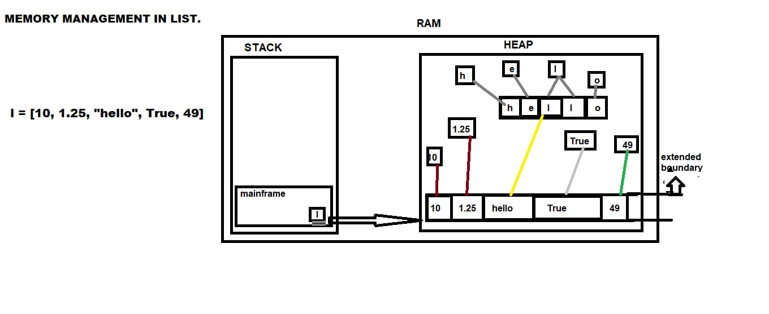
MEMORY MANAGEMENT IN LIST

Slide 118
INDEXING
The process of extracting single elements from the list is called as indexing
names = [‘apple’, ‘google’, ‘yahoo’, ‘gmail’, ‘amazon’, ‘flipkart’, ‘walmart’]
names[1] names[-1]
‘google’ ‘walmart’
names[4]
‘amazon’

Slide 119
names = [‘apple’, ‘google’, ‘yahoo’, [‘gmail’, ‘amazon’, ‘flipkart’], ‘walmart’]
names[3]
[‘gmail’, ‘amazon’, ‘flipkart’]
names[3][1]
‘amazon’
names[3[1]]
TypeError
l = [1, 2, 3, ['hello', 34, 4.5, ['python', 'world']], 3+4j, 'hello']
l[3][3][0] l[3][-1][0]
'python‘ 'python'

Slide 120
INDEXING AND SLICING
The process of extracting multiple elements/characters simultaneously is called as slicing
l = [1, 2, 3, ['hello', 34, 4.5, ['python', 'world']], 3+4j, 'hello']
l[3][0][1::] l[3][0][1:4:]
'ello‘ 'ell'
#i want to extract ‘thon’ in python.
l[3][3][0][2::]
'thon'
#i want to ‘hello’ in main list
l[-1] l[5]
'hello‘ 'hello'

Slide 121
MODIFICATION DONE ON THE LIST
It returns None because the modification will be applied on original list
names = ['apple', 'google', 'yahoo', 'amazon', 'walmart']
names[1:3] = ‘unknown’
names
['apple', 'u', 'n', 'k', 'n', 'o', 'w', 'n', 'amazon', 'walmart']
names[1:3] = ‘unknown’
names
'apple', 'u', 'n', 'k', 'n', 'o', 'w', 'n', 'k', 'n', 'o', 'w', 'n', 'amazon', 'walmart']

Slide 122
names = ['apple', 'google', 'yahoo', 'amazon', 'walmart']
names[1:3] = ['unknown']
names
['apple', 'unknown', 'amazon', 'walmart']
names = ['apple', 'google', 'yahoo', 'amazon', 'walmart']
names[0:1] = ['unknown', 'python', 'world']
names
['unknown', 'python', 'world', 'google', 'yahoo', 'amazon', 'walmart']
names = ['apple', 'google', 'yahoo', 'amazon', 'walmart']
names[::-1] = ['unkown']
ValueError: attempt to assign sequence of size 1 to extended slice of size 5

Slide 123
names = ['apple', 'google', 'yahoo', 'amazon', 'walmart']
names[-1] = ['zomato']
names
['apple', 'google', 'yahoo', 'amazon', ['zomato']]
names = ['apple', 'google', 'yahoo', 'amazon', 'walmart']
names[-1]
'walmart'
names
['apple', 'google', 'yahoo', 'amazon', 'walmart']

Slide 124
Dir(list)
['__add__', '__class__', '__class_getitem__', '__contains__', '__delattr__', '__delitem__', '__dir__', '__doc__', '__eq__', '__format__', '__ge__', '__getattribute__', '__getitem__', '__gt__', '__hash__', '__iadd__', '__imul__', '__init__', '__init_subclass__', '__iter__', '__le__', '__len__', '__lt__', '__mul__', '__ne__', '__new__', '__reduce__', '__reduce_ex__', '__repr__', '__reversed__', '__rmul__', '__setattr__', '__setitem__', '__sizeof__', '__str__', '__subclasshook__', 'append', 'clear', 'copy', 'count', 'extend', 'index', 'insert', 'pop', 'remove', 'reverse', 'sort']

Slide 125
Presentation 15 List elements: append(), extend(), insert() remove(), pop()

Slide 126
ADDING ELEMENTS IN LIST
append()
It adds an element at the end of the list.
Arguments passed in append() ---> objects(individual data types and collection data type)
syntax : var_name.append(objects)
l = [1, 2, 3, 4, 5, 6, 7, 8] l = [1, 2, 3, 4, 5, 6, 7, 8]
l.append(9) l.append('python')
l l
[1, 2, 3, 4, 5, 6, 7, 8, 9] [1, 2, 3, 4, 5, 6, 7, 8, 'python']

Slide 127
i want to append --> 'swiggy' , 'zomato‘
names = ['apple', 'google', 'yahoo', 'amazon', 'walmart']
names.append('swiggy', 'zomato')
TypeError: list.append() takes exactly one argument (2 given)
names.append(['swiggy', 'zomato'])
names
['apple', 'google', 'yahoo', 'amazon', 'walmart', ['swiggy', 'zomato']]
names = ['apple', 'google', 'yahoo', 'amazon', 'walmart']
names.append('swiggy, zomato')
names
['apple', 'google', 'yahoo', 'amazon', 'walmart', 'swiggy, zomato']

Slide 128
extend()
It extend the extending list with the items of the given sequence.
Arguments passed in extend() ---> iterables
syntax : var_name.extend(iterables)
l = [1, 2, 3, 4, 5, 6, 7, 8]
l.extend(9)
TypeError: 'int' object is not iterable
l.extend([9])
l
[1, 2, 3, 4, 5, 6, 7, 8, 9]
l.extend('9')

Slide 129
names = ['apple', 'google', 'yahoo', 'amazon', 'walmart']
names.extend([10])
names
['apple', 'google', 'yahoo', 'amazon', 'walmart', 10]
names = ['apple', 'google', 'yahoo', 'amazon', 'walmart']
names.extend(['python'])
names
['apple', 'google', 'yahoo', 'amazon', 'walmart', 'python']
names = ['apple', 'google', 'yahoo', 'amazon', 'walmart']
names.extend('python')
names
['apple', 'google', 'yahoo', 'amazon', 'walmart', 'p', 'y', 't', 'h', 'o', 'n']
note: if we want to add a complete string as it is to the list pass it in boundary[], and if we pass string as it is without boundary it will consider each character as an element.

Slide 130
names = ['apple', 'google', 'yahoo', 'amazon', 'walmart']
names.extend('apple', '@', 'google_.com')
TypeError: list.extend() takes exactly one argument (3 given)
names = ['apple', 'google', 'yahoo', 'amazon', 'walmart']
names.extend(['apple', '@', 'google_.com'])
names
['apple', 'google', 'yahoo', 'amazon', 'walmart', 'apple', '@', 'google_.com‘]
names = ['apple', 'google', 'yahoo', 'amazon', 'walmart']
company = ['capgemini', 'MS', 'youtube']
names.extend(company)
names
['apple', 'google', 'yahoo', 'amazon', 'walmart', 'capgemini', 'MS', 'youtube']

Slide 131
insert():
It adds an element at the specified position.
Arguments passed in insert() ---> object(both individaul and collection datatypes)
insert() takes 2 arguments ---> element and postion(index)
syntax : var_name.insert(position, element)
names = ['apple', 'google', 'yahoo', 'amazon', 'walmart']
names.insert(2, 'Micorsoft')
names
['apple', 'google', 'Micorsoft', 'yahoo', 'amazon', 'walmart']
names = ['apple', 'google', 'yahoo', 'amazon', 'walmart']
names.insert(-3, 'flipkart')
names
['apple', 'google', 'flipkart', 'yahoo', 'amazon', 'walmart']

Slide 132
REMOVING ELEMENTS FROM LIST
remove():
It removes first occurance of the element/value specified.
Arguments passed in remove() ---> elements/values
syntax : var_name.remove(elements)
names = ['apple', 'google', 'yahoo', 'amazon', 'walmart', 'apple', 'flipkart']
names.remove('amazon')
names
['apple‘, 'google', 'yahoo', 'walmart', 'apple', 'flipkart']
Note: the return type of remove() is None

Slide 133
names = ['apple', 'google', 'yahoo', 'amazon', 'walmart', 'apple', 'flipkart']
names.remove(3)
ValueError: list.remove(x): x not in list
Note: if the element is not present in the list it raises Value Error
names = ['apple', 'google', 'yahoo', 'amazon', 'walmart', 'apple', 'flipkart']
names.remove('apple', 'google')
TypeError: list.remove() takes exactly one argument (2 given)
names.remove()
TypeError: list.remove() takes exactly one argument (0 given)
Note: remove() takes exactly one argument if we dont pass any argument it raises Type Error

Slide 134
pop():
It removes the element at the specified position
arguments passed in pop() --> index position
syntax : var_name.pop(index position)
pop() returns removed element as its return type
names = ['apple', 'google', 'yahoo', 'amazon', 'walmart', 'apple', 'flipkart']
names.pop(3)
'amazon'
names
['apple', 'google', 'yahoo', 'walmart', 'apple', 'flipkart']

Slide 135
names = ['apple', 'google', 'yahoo', 'amazon', 'walmart', 'apple', 'flipkart']
names.pop(-2)
'apple'
names
['apple', 'google', 'yahoo', 'amazon', 'walmart', 'flipkart‘
names = ['apple', 'google', 'yahoo', 'amazon', 'walmart', 'apple', 'flipkart']
names.pop(2, -1)
TypeError: pop expected at most 1 argument, got 2

Slide 136
Note: in pop() if we don't pass any argument by default it will pop last element present in list
names = ['apple', 'google', 'yahoo', 'amazon', 'walmart', 'apple', 'flipkart']
names.pop()
'flipkart'
names.pop()
'apple'
names.pop()
'walmart'
names.pop()
'amazon'
names.pop()
'yahoo'
names.pop()
'google'
names.pop()
'apple'
names.pop()
IndexError: pop from empty list
note: We cannot pop an element from an empty list, it raises Index Error because we pass index position as an argument.

Slide 137
bikes = ['yamahaR15', 'RoyalEnfield', 'Pulsar220', 'BajajChetak', 'Suzuki samurai', 'Kawasaki ninja', 'Yamaha RX100', 'Scooty Zest', 'Honda Activa']
bikes.pop(-4)
‘Kawasaki ninja’
bikes
['yamahaR15', 'RoyalEnfield', 'Pulsar220', 'BajajChetak', 'Suzuki samurai', 'Yamaha RX100', 'Scooty Zest', 'Honda Activa']
bikes.pop()
'Honda Activa'
bikes
['yamahaR15', 'RoyalEnfield', 'Pulsar220', 'BajajChetak', 'Suzuki samurai', 'Yamaha RX100', 'Scooty Zest']

Slide 138
Diffence between Remove() And Pop()
remove() :
It removes the first occurance of the element
It takes element as an argument and the return type is None
If the element is not present in the list it raises ValueError
It takes exaclty one argument.
pop() :
it removes the element at the specified position
pop() takes index position as an argument and it returns removed element as its return type
If we dont pass any argument(index position) it pops last element by default
if the index is out of range it raises IndexError.

Slide 139
Presentation 16 List elements: clear(), del() Index(), count()

Slide 140
clear():
It is used to clear the elements present in the list
It takes no arguments
Syntax : var_name.clear( )
names = ['apple', 'google', 'yahoo', 'amazon', 'walmart', 'apple', 'flipkart']
names.clear( )
names
[]
note: The return type of clear( ) is None and the o/p will be empty list
names = ['apple', 'google', 'yahoo', 'amazon', 'walmart', 'apple', 'flipkart']
names.clear('apple')
TypeError: list.clear() takes no arguments (1 given)

Slide 141
numbers = [1,2 , 3, 5, 5,6,78]
numbers.clear()
numbers
[]
cars = ['Skoda Rapid', 'Tata Nexon', 'Kia Sonet', 'Audi Q7', 'Rangerover', 'MG hector', 'wolksvagen polo', 'ford figo', 'Hyundai verna', 'Maruthi 800', 'Mahindra Thar']
cars.clear()
cars
[]

Slide 142
Del:
It is used to deallocate/delete the entire list including variable name also
names = ['apple', 'google', 'yahoo', 'amazon', 'walmart', 'apple', 'flipkart']
del names[1:3]
names
['apple', 'amazon', 'walmart', 'apple', 'flipkart']
del names[-1]
names
['apple', 'amazon', 'walmart', 'apple']
del names[0:1:1]
names
['amazon', 'walmart', 'apple']

Slide 143
index():
It returns the index of the first element with specified value
syntax : var_name.index('element')
names = ['apple', 'google', 'yahoo', 'amazon', 'walmart', 'apple', 'flipkart']
names.index('apple')
0
names.index('apple', 1)
5
names = ['apple', 'google', 'yahoo', 'amazon', 'walmart', ['apple', 'flipkart']]
names.index(['apple', 'flipkart'])
5
names.index('apple', 1)
ValueError: 'apple' is not in list

Slide 144
count():
It returns the number of occurance of the specified element, it exactly takes one argument
syntax : var_name.count(element)
names = ['apple', 'google', 'yahoo', 'amazon', 'walmart', 'apple', 'flipkart', 'google', 'apple', 'yahoo', 'google', 'flipkart', 'google']
names.count('google')
4
names.count('amazon')
1
names.count('facebook')
0
names.count('flipkart', 'apple')
TypeError: list.count() takes exactly one argument (2 given)

Slide 145
sort():
It sorts the list
In order to sort the list, The list should be homogenous
the sorting happens in the original list itself and return type of sort() is None
Ascending Order:
names = ['apple', 'google', 'yahoo', 'amazon', 'walmart', 'apple', 'flipkart']
names.sort()
names
['amazon', 'apple', 'apple', 'flipkart', 'google', 'walmart', 'yahoo']

Slide 146
names = ['apple1', 'google', 'yahoo', 'amazon', 'walmart', 'apple2', 'flipkart']
names.sort()
names
['amazon', 'apple1', 'apple2', 'flipkart', 'google', 'walmart', 'yahoo']
note: by default sort() sorts the list in Ascending order
Descending order:
names = ['apple1', 'google', 'yahoo', 'amazon', 'walmart', 'apple2', 'flipkart']
names.sort(reverse = True)
names
['yahoo', 'walmart', 'google', 'flipkart', 'apple2', 'apple1', 'amazon']

Slide 147
Arranging according to length – ascending order
names = ['apple1', 'google', 'yahoo', 'amazon', 'walmart', 'apple2', 'flipkart']
names.sort(key = len)
names
['yahoo', 'apple1', 'google', 'amazon', 'apple2', 'walmart', 'flipkart']
Arranging according to length – Descending order
names = ['apple1', 'google', 'yahoo', 'amazon', 'walmart', 'apple2', 'flipkart']
names.sort(key= len, reverse = True)
names
['flipkart', 'walmart', 'apple1', 'google', 'amazon', 'apple2', 'yahoo']

Slide 148
Presentation 17 Copy() Tuple

Slide 149
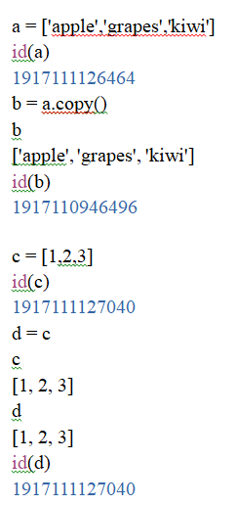
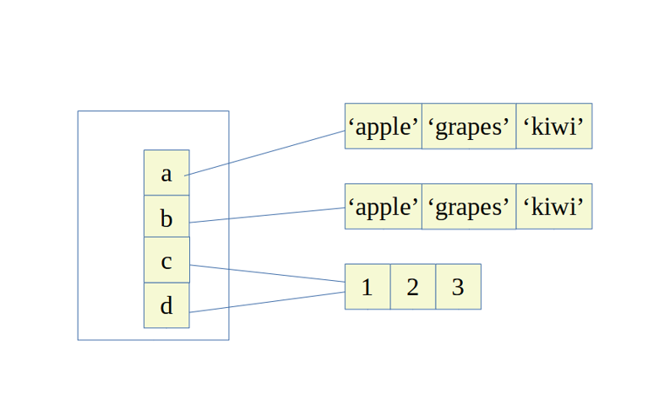
COPY
It is mainly used to copy the values present in one variable to another

Slide 150
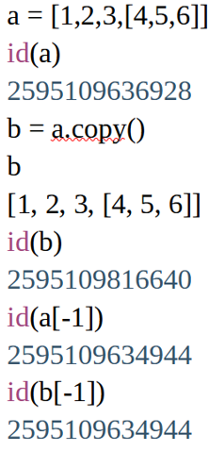
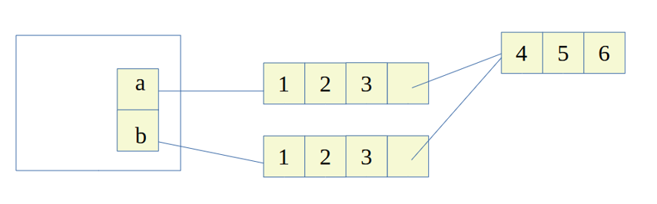
Copy operation can be performed in 2 ways: Shallow copy & Deep copy
Shallow copy
1. It is performed using a built-in method called as ‘copy’. dir(list)
2. It creates a separate memory block for both variables having same values but not for nested values.

Slide 151
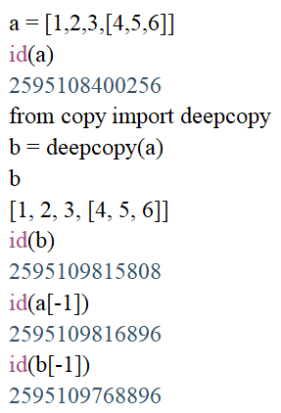
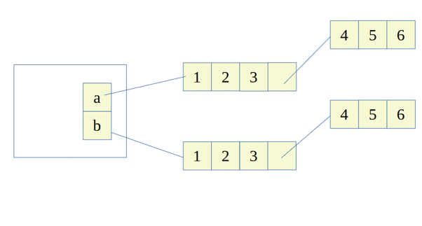
Deep copy
1. It isn’t a built-in function, so we need to import a module called as ‘copy’. (don’t import: SyntaxError)
2. It creates a separate memory block for both variables having same values, also for nested values.

Slide 152
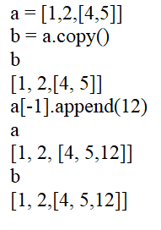
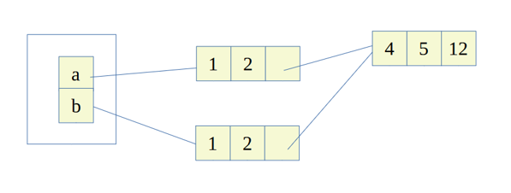
When nested list are modified:
SHALLOW COPY
There will be relation between two variables with same values if they have the same nested list.
Any modification done on the nested values of one variable will have an impact on the nested value of another variable.

Slide 153
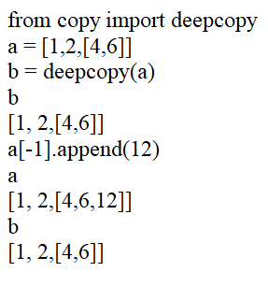
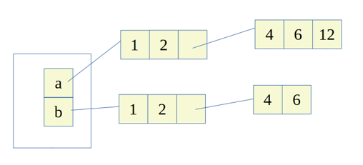
DEEP COPY
There wont be relation between both the variables.
Any modification done on the nested values of one variable will not have an impact on the nested value of another variable.

Slide 154
TUPLE
It is a collection of homogeneous and heterogeneous elements
Each element is separated by comma operator
Boundary to denote tupe →(………..) → paenthesis
Syntax: Var_name = (ele1, ele2, ele3,……..)
Indexing and slicing is a similar as to that of list and string
Length of tuple → len(Var_name)
Tuple is a immutable data type
NOTE: Tuples are faster than list
Tuples has a closed boundary

Slide 155
Ways to create tuple:
t = (‘hello’, 123, 4.56, [2, 3, 4,], (23, 45))
type(t)
<class ‘tuple’>
Creating an empty tuple
t = ()
type()
<class’tuple’>
Another way
t = tuple()
type(t)
<class’tuple’>

Slide 156
How to create single element/value in tuple
tuple = (1) tuple(1,)
type(tuple) type(tuple)
<class’int’> <class’tuple’
NOTE: If we want to create a single value in a tuple, write one element followed with comma operator, because if we don’t separate by comma it will not considered as tuple
dir(tuple)
['__add__', '__class__', '__class_getitem__', '__contains__', '__delattr__', '__dir__', '__doc__', '__eq__', '__format__', '__ge__', '__getattribute__', '__getitem__', '__getnewargs__', '__gt__', '__hash__', '__init__', '__init_subclass__', '__iter__', '__le__', '__len__', '__lt__', '__mul__', '__ne__', '__new__', '__reduce__', '__reduce_ex__', '__repr__', '__rmul__', '__setattr__', '__sizeof__', '__str__', '__subclasshook__', 'count', 'index']

Slide 157
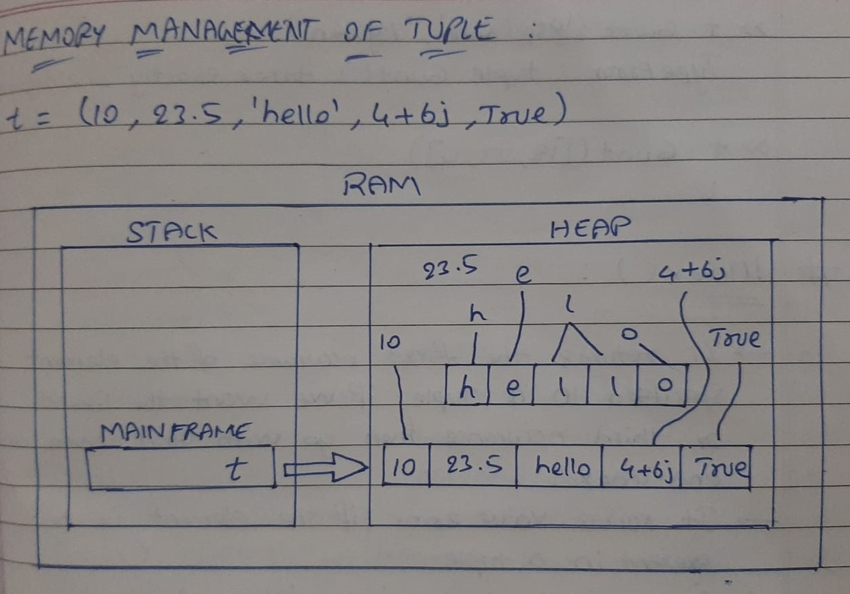
MEMORY MANAGEMENT OF TUPLE

Slide 158
COUNT():
It returns the no. of items of a specified value in tuple
Syntax: Var_name.count(element/value)
t = (10, ‘hello’, ‘python’, 23, 10, ‘hello’, [12, 23, 4], ‘hello’, 10)
t.count(10)
3
t.count(‘hello’)
3
t.count(‘bye’)
o
t.count(‘hello’, 10)
TypeError: tuple count () takes only one argument

Slide 159
INDEX():
It returns the first occurrence of the element specified in a tuple, if we want the second or third occurrence then go with start index and end index’it raises value error if the element is not present in a tuple
Syntax: Var_name.index(element)
t = (10, ‘hello’, ‘python’, 23, 10, ‘hello’, [12, 23, 4], ‘hello’, 10)
t.index(10)
0
t.index(‘hello’)
1
t.index(‘hello’, 2)
5

Slide 160
Presentation 18 SET Introduction, Union(), Intersection(), Difference(), Symmetric_Difference()

Slide 161
SET
Set is unordered which is random
Elements in set are unique → it doesn’t allow duplicates
Set is mutable but the items/elements inside set must be immutable
Since set is unordered we cannot do indexing and slicing
Syntax: Var_name = {item1, item2, item3, ……}
a = {} b = {1, 2, 3}
type(a) type(b)
<class ‘dict’> <class ‘set’>

Slide 162
If we want to write an empty set
s = set() #set constructor
type(s)
<class ‘set’>
If we want to find length of the set → len(Var_name)
s = {2, 4, 6, 8, 0, 10, 12} s = {2, 4, 6, 8, 0, 10, 12, 2, 4, 6, 8, 0, 10, 12}
len(s) len(s)
7 7
#Dir(set)
['add', 'clear', 'copy', 'difference', 'difference_update', 'discard', 'intersection', 'intersection_update', 'isdisjoint', 'issubset', 'issuperset', 'pop', 'remove', 'symmetric_difference', 'symmetric_difference_update', 'union', 'update']

Slide 163
Unhashable → Mutable data type
Hashable → Immutable data type
s = {2, 6, 8, [1, 2, 3], {2, 5, 7}}
Type Error: unhashable type: ‘list’ #list is mutable
s = {1, 2, 3, 4, ‘hello’, (1, 2, 3)}
s
{1, 2, 3, 4, 'hello', (1, 2, 3)}
s[2] s[2:5]
type error type error

Slide 164
UNION():
It returns a set that contains all the items from the original set and all items from specified sets
Syntax: set.union (set2)
s = {1, 2, 3, 4}
s1 = {5, 6, 7, 8}
s.union(s1)
{1, 2, 3, 4, 5, 6, 7, 8}
s2 = s.union(s1)
s2
{1, 2, 3, 4, 5, 6, 7, 8}
s2 = {2,4,6,8,10}
s1 = {5,6,7,8}
s1.union(s2)
{2,4,5,6,7,8,10}
st = {‘hello’, ‘python’, ‘world’}
st1 = {‘program’, ‘Python’, ‘world’}
st.union(st1)
{‘world’, ‘hello’, ‘Python’, ‘python’, ‘program’}

Slide 165
INTERSECTON():
It returns a set that contains the similarity between two or more sets
Syntax: set1.intersection(set2)
s = {1,2,3,4,5}
s1 = {1,3,5,7}
s.intersection(s1)
{1,3,5}
st = {‘hello’, ‘python’, ‘world’}
st1 = {‘program’, ‘Python’, ‘world’}
st.intersection(st1)
{‘world’}
s = {(1,2,3), (4,5,6)}
s1 = {(3,2,1), (4,5,6)}
s.intersection(s1)
{(4,5,6)}

Slide 166
DIFFERENCE():
It returns a set containing the difference between two or more sets
The returned set contains items/elements that exist only in base set
Base set: The first set which we write before applying function
Reference set: The set which is written inside the braises
s = {2,4,6,8,10}
s1 = {3,6,9,12}
s.difference(s1)
{8,2,10,4}
s1.difference(s)
{9,3,12}
s = {‘hello’, 45, 10.35, (1, 2, 3), 3+4j}
s1 = {(3, 2, 1), 65, ‘hello’, ‘10.35’}
s.difference(s1)
{10.35, (1, 2, 3), 45, (3+4j)}
s1.difference(s)
{‘10.35’, 65, (3, 2, 1)}

Slide 167
SYMMETRIC_DIFFERENCE():
It returns a set that contains all the items which are not common among all the sets
a = {1, 2, 3, 4}
b = {3, 6, 9, 10}
a.symmetric_difference(b)
{1, 2, 4, 6, 9, 10}
s = {‘google’, ‘gmail’, ‘yahoo’}
s1 = {‘fb’, ‘googel’, ‘gmail’, ‘yahoo’}
s.symmetric_difference(s1)
{‘googel’, ‘google’, ‘fb’}

Slide 168
Presentation 19 Set methods: intersection_update(), Difference_update(), symmetric_difference_update() Adding: Add(), Update() Removing: Remove(), Discard(), Pop()

Slide 169
SET METHODS
Intersection_update()
It modifies the set by retaining only elements found in both sets
s = {2,4,6,8,10}
s1 = {3,6,9,12}
s.intersection_update(s1)
s
{6}
s1
{9,3,12,6}
NOTE: When we are performing intersection_update() the base set which we specify it will modify/update with common elements present in the both the sets and the reference set remains same
s = {‘google’, ‘gmail’, ‘hello’, ‘whatsapp’, ‘hello’}
s1 = {‘fb’,’insta’, ‘google’, ‘hello’, ‘netflix’}
s.intersection_update(s1)
s
{‘google’, ‘hello’}
s1
{‘google’, ‘hello’, ‘insta’, ‘netflix’, ‘fb’}

Slide 170
Difference_update():
It updates the base set with elements that are present in base set but not in reference set
s = {‘google’, ‘gmail’, ‘yahoo’}
s1 = {‘fb’, ‘insta’, ‘google’}
s.difference_update(s1)
s
{‘gmail’, ‘yahoo’}
s1
{‘fb’, ‘google’, ‘insta’}
s = {‘python’, ‘world’, ‘programming’, ‘Programming}
s1 = {‘234’, ‘World’, ‘programming’, ‘Programming’}
s.difference_update(s1)
s
{‘python’, ‘world’}
s1
{‘234’, ‘World’, ‘Programming’, ‘programming’}

Slide 171
Difference between difference() & difference_update()
Difference() | Difference_update
In difference(), it removes/eliminates common elements present in both the set and returning the elements of both set The original base set remains same in difference() | In difference_update(), it removes/eliminates common elements present in both set and updates base set, and returns updated base set The reference set remains same

Slide 172
Symmetric_difference_update():
It updates the base set with the items that are not common among all the sets(both the sets)
s = {‘google’, ‘gmail’, ‘fb’, ‘windows’}
s1 = {‘yahoo’, ‘unknown’, ‘insta’}
s.symmetric_difference_update(s1)
s
{‘yahoo’, ‘windows’, ‘fb’, ‘google’, ‘unknown’, ‘insta’, ‘gmail’}
s1
{‘unknown’, ‘yahoo’, ‘insta’}

Slide 173
Adding items into set
Add()
Update()
Add()
it adds an item(individual and collection), to the existing set, if the item already exist, the add() methods does not add the elements
s = {‘apple’, ‘google’, ‘yahoo’}
s.add(420)
s
{‘google’, 420, ‘apple’, ‘yahoo’}

Slide 174
NOTE: add() takes both individual and collection data types, but in collection data type it takes only immutable data types
s = {‘python’, ‘world’, ‘programming’}
s.add(‘gmail’)
s
{‘python’, ‘gmail’, ‘world’, ‘programming’}
s.add([1, 2, 3])
s
Type error
s.add((1,2,3))
{‘gmail’, ‘python’, ((1,2,3)), ‘world’, ‘programming’}

Slide 175
Update():
It updates the current set by adding items from any iterable
Syntax: Var_name.update(iterable)
s = {‘fb’, ‘gmail’, ‘google’}
s.update(‘gmail’)
s
{‘a’, ‘g’, ‘fb’, ‘google’, ‘l’, ‘i’, ‘gmail’, ‘m’}
s.update([‘gmail’])
s
{‘fb’, ‘gmail’, ‘google’}
s.update(123)
Type error: ‘int’ object is not iterable
s.update({123})
s
{‘fb’, ‘google’, 123, ‘gmail’}
s.update([[123]])
Type error: unhashable type ‘list’

Slide 176
Removing items from set
remove()
discard()
pop()
Remove()
It removes the specified items from set
Syntax: Var_name.remove(item)
s = {‘google’, 10, ‘yahoo’, ‘gmail’, ‘fb’, ‘yahoo’}
s.remove(‘yahoo’)
a
{‘fb’, 10, ‘gmail’, ‘google’}
NOTE: Since set does not allow duplicates, no matter how many same kind of items we pass it will consider as single item
s = {‘google’, 10, ‘yahoo’, ‘gmail’, ‘fb’}
s.remove(‘zomato’)
Key error:
NOTE: if the item is not present in the set it raises key error

Slide 177
Discard()
It removes specified items from the set
Syntax: Var_name.discard(item)
s = {‘google’, ‘gmail’, 10, ‘yahoo’, ‘fb’}
s.discard(10)
s
{‘fb’, ‘gmail’, ‘yahoo’, ‘google’}
s = {‘google’, 10, ‘yahoo’, ‘gmail’, ‘fb’}
s.remove(‘zomato’)
{‘yahoo’, ‘google’, ‘fb’,10, ‘gmail’}
NOTE: In discard() we wont be getting key error when the item is not present in the set as like removes()
To avoid the error while removing items from the set we go for discard()

Slide 178
Pop():
It removes random item from the set
It will return the removed item
Syntax: Var_name.pop() → no argument
s = {'apple', 'google', 'gmail', (1,2,3), 12.3, 'yahoo', 78}
s.pop()
'google'
s.pop()
'yahoo'
s.pop()
'gmail'
s.pop()
'apple'
s.pop()
12.3
s.pop()
78
s.pop()
(1, 2, 3)
s.pop()
KeyError: 'pop from an empty set'

Slide 179
Presentation 20 Dictionary Introduction, Memory management, ways to create dictionary

Slide 180
DICTIONARY
OVER VIEW
Collection of key – value pair
Each element is associated with unique key
Separated by comma operator
Boundary: {…….}
Length: len(Var_name)
It does not support indexing and slicing
d = { }
type(d)
<class ‘dict’>
CHARACTERISTICS OF DICTIONARY
Key cannot be duplicated
Key will be single element
Values can be of any data types
Values can be accessed through key only
Keys must be immutable data type or hashable

Slide 181
d = {‘a’: ‘apple’, ‘b’: ‘ball’, ‘c’: ‘cat’ }
type(d)
<class ‘dict’>
NOTE: While assigning into dictionary keys to be immutable and values can be of any data types
d = {‘a’: ‘apple’, [1,2,3]: [3,2,1], 12: ‘twelve’}
Type Error: unhashable ‘list’
d = {‘a’: ‘apple’, {1,2,3}: [3,2,1], 12: ‘twelve’}
Type error: unhashable ‘set’
Dir(dict)
['clear', 'copy', 'fromkeys', 'get', 'items', 'keys', 'pop', 'popitem', 'setdefault', 'update', 'values']

Slide 182
MEMORY MANAGEMENT OF DICTIONARY:
d = {‘a’: 25, ‘b’: 28, ‘c’: 30, ‘d’: 34, ‘e’: 25}
Value layer / Value space
Key layer / key space
Only key layer will be visible, value layer will be hidden behind the key layer, that’s why when we want to access values we go with keys
a | b | c | d | e
25 | 28 | 30 | 34 | 25

Slide 183
LENGTH: len(Var_name)
d = {‘a’: ‘apple’, ‘b’: ‘ball’, ‘c’: ‘cat’ }
len(d)
3
WAYS TO CREATE DICTIONARY
1. Empty dictionary → d = { }
2. dict constructor → dict( )
Dict constructor
d = {a= 25, b= 28, c= 30, d= 34}
d
{‘a’: 25, ‘b’: 28, ‘c’: 30, ‘d’: 34}

Slide 184
List of tuples
d = dict([(‘a’, 25), (‘b’, 22), (‘c’, 25), (‘d’, 33), (‘e’, 29)])
d
{‘a’: 25, ‘b’: 22, ‘c’: 25, ‘d’: 33, ‘e’:29}
{key: value}
d = dict({‘a’: 25, ‘b’: 22, ‘c’: 25, ‘d’: 33, ‘e’: 29})
d
{‘a’: 25, ‘b’: 22, ‘c’: 25, ‘d’: 33, ‘e’: 29}
d = dict({‘a’: 25, ‘b’: 22, ‘c’: 25, ‘d’: 33, ‘e’: 29,30})
syntax error:
d = dict({‘a’: 25, ‘b’: 22, ‘c’: 25, ‘d’: 33, ‘e’: (29,30)})
{‘a’: 25, ‘b’: 22, ‘c’: 25, ‘d’: 33, ‘e’: (29,30)}

Slide 185
d = {‘apple’: 25, ‘b’: 22, ‘c’: 25, ‘d’: 33, ‘e’: 29, ‘b’: 30}
d
{‘apple’: 25, ‘b’: 30, ‘c’: 25, ‘d’: 33, ‘e’: 29}
NOTE: Key cannot be duplicated, if it takes it will result in update / latest value.
We can have duplicate values
# if we want tuple as a key → composite key
# composite key: making tuple as a key
holidays = {(‘jan’, 26): ‘republic day’, (‘aug’, 15): ‘independence day’, (‘jan’, 21): ‘yoga day}
holidays
{(‘jan’, 26): ‘republic day’, (‘aug’, 15): ‘independence day’, (‘jan’, 21): ‘yoga day}

Slide 186
Presentation 21 Dictionary: Key-value, Get(), Keys(), Values(), Items()

Slide 187
ACCESSING VALUS FROM KEYS
Key – value syntax
Get()
Key-value:
d = {1: ‘one’, 2: ‘two’, 3: ‘three’, 4: ‘four’}
d[‘one’]
key error:
d[1] d[2]
‘one’ ‘two’
NOTE: only key layer will be visible, vale layer will be hidden behind the key layer, that’s why when we want to access value we go with keys
d = {‘apple’: 25, ‘b’: 22, ‘c’: 25, ‘d’: 33, ‘e’: 29}
d[‘apple’]
25

Slide 188
Get():
It returns the values of the item with specified key
Syntax: Var_name.get(key) and Var_name.get(key, message)
d = {‘apple’: 25, ‘b’: 22, ‘c’: 25, ‘d’: 33, ‘e’: 29}
d.get(‘apple’)
25
NOTE: in get() if key is present it will return its value if not it will return the message by default the 2nd argument is → None
d = {‘apple’: 25, ‘b’: 22, ‘c’: 25, ‘d’: 33, ‘e’: 29}
d.get(‘a’, ‘key is not present in dictionary’)
‘key is not present in dictionary’

Slide 189
How to access only keys, only values and both items
Keys()
It returns a list of all keys present in dictionary
List will reflect any changes done in the dictionary
Syntax: Var_name.keys()
d = {‘apple’: 25, ‘b’: 22, ‘c’: 25, ‘d’: 33, ‘e’: 29}
d.keys()
dict_keys([‘apple’, ‘b’, ‘c’, ‘d’, ‘e’])

Slide 190
Values():
It returns the list of all the values present in a dictionary
Syntax: Var_name.values()
d = {‘apple’: 25, ‘b’: 22, ‘c’: 25, ‘d’: 33, ‘e’: 29}
d.values()
dict_values([25, 22, 25, 33, 29])
Items():
It returns the key – value pair of dictionary in list of tuples
Syntax: Var_name.items()
d = {‘apple’: 25, ‘b’: 22, ‘c’: 25, ‘d’: 33, ‘e’: 29}
d.items()
dict_items[(‘apple’: 25), (‘b’: 22), (‘c’: 25), (‘d’: 33), (‘e’: 29)]

Slide 191
Presentation 22 Dictionary: key-value syntax,update(), set default(), from keys()

Slide 192
Adding key – value pair in dictionary
1. Key – value syntax
Syntax: Var_name[keys] = Value
d = {‘apple’: 25, ‘b’: 22, ‘c’: 25, ‘d’: 33, ‘e’: 29}
d[‘f’] = 18
d
{‘apple’: 25, ‘b’: 22, ‘c’: 25, ‘d’: 33, ‘e’: 29, ‘f’: 18}
d = {‘apple’: 25, ‘b’: 22, ‘c’: 25, ‘d’: 33, ‘e’: 29, ‘f’: 18}
d[‘g’, ‘h’] = 23, 28
d
{‘apple’: 25, ‘b’: 22, ‘c’: 25, ‘d’: 33, ‘e’: 29, ‘f’: 18, (‘g’, ‘h’): (23,28)}

Slide 193
d = {‘apple’: 25, ‘b’: 22, ‘c’: 25, ‘d’: 33, ‘e’: 29}
d[‘b’] = 32
d
{‘apple’: 25, ‘b’: 32, ‘c’: 25, ‘d’: 33, ‘e’: 29}
NOTE: If the item(key – value) is already exist in a dictionary and if we add same key and different value it will update to latest value
2. Update()
It will update the existing dictionary with specified items
d = {‘apple’: 25, ‘b’: 22, ‘c’: 25, ‘d’: 33, ‘e’: 29}
d.update(‘f’= 30)
syntax error:
d.update(f= 30)
d
{‘apple’: 25, ‘b’: 22, ‘c’: 25, ‘d’: 33, ‘e’: 29, ‘f’: 30}

Slide 194
d = {‘apple’: 25, ‘b’: 22, ‘c’: 25, ‘d’: 33, ‘e’: 29}
d.update(f= 30, g= 20, h= 30, i= 40, j= 50)
d
{‘apple’: 25, ‘b’: 22, ‘c’: 25, ‘d’: 33, ‘e’: 29, ‘f’: 30, ‘g’: 20, ‘h’: 30, ‘i’: 40, ‘j’: 50}
NOTE: In update() we can update multiple items() simultaneously by using key-word parameters, normal dictionary form and in a list of tuples
3. Set default():
It returns the value of the item with specified key, if the value is not specified it adds None as its value and returns
If the key does not exist, it will insert the key, with specified value

Slide 195
d = {‘apple’: 25, ‘b’: 22, ‘c’: 25, ‘d’: 33, ‘e’: 29}
d.setdefault(‘f’)
d
{‘apple’: 25, ‘b’: 22, ‘c’: 25, ‘d’: 33, ‘e’: 29, ‘f’: None}
d.setdefault(‘f’, 34)
{‘apple’: 25, ‘b’: 22, ‘c’: 25, ‘d’: 33, ‘e’: 29, ‘f’: None}
d = {‘apple’: 25, ‘b’: 22, ‘c’: 25, ‘d’: 33, ‘e’: 29}
d.setdefault(‘g’, 23)
{‘apple’: 25, ‘b’: 22, ‘c’: 25, ‘d’: 33, ‘e’: 29, ‘g’: 23}

Slide 196
4. From keys()
It returns a dictionary with specified key and specified value
Keys are mandatory, an iterable specifying key of the new dictionary
Values are optional, the values for all the keys is None by default
l = [‘a’, ‘b’, ‘c’]
d = {}
op = d.from keys(l, ‘alphabet’)
op
{‘a’: ‘alphabet’, ‘b’: ‘alphabet’, ‘c’: ‘alphabet’}
l = [‘a’, ‘b’, ‘c’]
d = {}
op = d.from keys(l)
op
{‘a’: ‘None’, ‘b’: ‘None’, ‘c’: ‘None’}

Slide 197
names = ['apple','google','microsoft','capgemini']
sw_cmp = {}
op = sw_cmp.fromkeys(names, 'software company')
op
{'apple': 'software company', 'google': 'software company', 'microsoft': 'software company', 'capgemini': 'software company'}
string = 'python'
d = {}
op = d.fromkeys(string, 'character')
op
{'p': 'character', 'y': 'character', 't': 'character', 'h': 'character', 'o': 'character', 'n': 'character'}

Slide 198
Presentation 23 Dictionary: pop(), popitem(), Merge two dictionaries

Slide 199
REMOVING METHODS FROM DICTIONARY
1. Pop():
It removes the specified item from dictionary and returns the value as output
d = {‘apple’: 25, ‘b’: 22, ‘c’: 25, ‘d’: 33, ‘e’: 29}
d.pop(‘apple’)
25
d
{‘b’: 22, ‘c’: 25, ‘d’: 33, ‘e’: 29}
d = {‘apple’: 25, ‘b’: 22, ‘c’: 25, ‘d’: 33, ‘e’: 29}
d.pop()
Type error: pop expects atleast 1, got 0
NOTE: in pop() → the 1st argument is key, and 2nd argument is message
d.pop(‘f’, ‘key is not present in dictionary’)
‘key is not present in dictionary’

Slide 200
2. Popitem():
It removes the item that was inserted at last into the dictionary
d = {‘apple’: 25, ‘b’: 22, ‘c’: 25, ‘d’: 33, ‘e’: 29}
d.popitem()
(‘e’, 29)
{‘apple’: 25, ‘b’: 22, ‘c’: 25, ‘d’: 33}
NOTE: it takes no argument, it will pop both key and value present at last in a dictionary and returns popped key value in a tuple
d.popitem()
('d', 33)
d.popitem()
('c', 25)
d.popitem()
('b', 22)
d.popitem()
('apple', 25)
d.popitem()
KeyError: 'popitem(): dictionary is empty'

Slide 201
MERGE TWO DICTIONARIES
d = {‘apple’: 25, ‘b’: 22, ‘c’: 25, ‘d’: 33, ‘e’: 29}
m = {‘f’: 35, ‘g’: 40, ‘h’: 45}
d_m = {*d, *m}
{‘apple’, ‘b’, ‘c’, ‘d’, ‘e’, ‘f’, ‘g’, ‘h’}
NOTE: if we use single (*) it will unpack only the keys from both dictionaries
if we want to unpack both key and values then we use (**)
d = {‘apple’: 25, ‘b’: 22, ‘c’: 25, ‘d’: 33, ‘e’: 29}
m = {‘f’: 35, ‘g’: 40, ‘h’: 45}
d_m = {**d, **m}
{‘apple’: 25, ‘b’: 22, ‘c’: 25, ‘d’: 33, ‘e’: 29, ‘f’: 35, ‘g’: 40, ‘h’: 45}

Slide 202
Another way:
d = {‘apple’: 25, ‘b’: 22, ‘c’: 25, ‘d’: 33, ‘e’: 29}
m = {‘f’: 35, ‘g’: 40, ‘h’: 45}
d_m = d | m
{‘apple’: 25, ‘b’: 22, ‘c’: 25, ‘d’: 33, ‘e’: 29, ‘f’: 35, ‘g’: 40, ‘h’: 45}
d = {‘apple’: 25, ‘b’: 22, ‘c’: 25, ‘d’: 33, ‘e’: 29}
m = {‘f’: 35, ‘g’: 40, ‘h’: 45}
n = {‘i’: ‘apple’, ‘j’: ‘ball’, ‘k’: ‘cat’}
0 = {‘l’: ‘dog’, ‘m’: ‘elephant’}
s = d | m | n | o
s
{‘apple’: 25, ‘b’: 22, ‘c’: 25, ‘d’: 33, ‘e’: 29, ‘f’: 35, ‘g’: 40, ‘h’: 45, ‘i’: ‘apple’, ‘j’: ‘ball’, ‘k’: ‘cat’, ‘l’: ‘dog’, ‘m’: ‘elephant’}

Slide 203
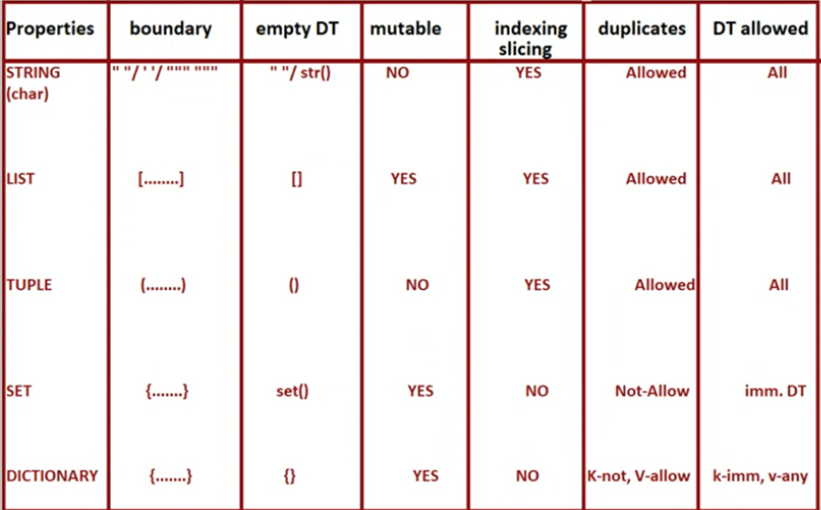
DATA TYPES RIVISION

Slide 204
Presentation 24 Type casting individual data type: Int(), Float(), Complex(), Bool() Collection data type: String()

Slide 205
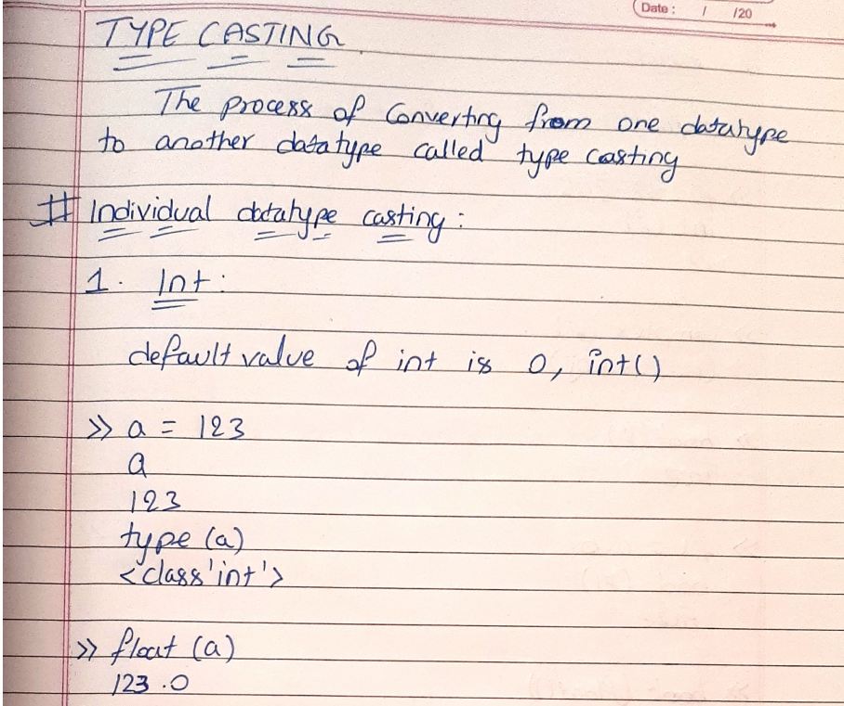
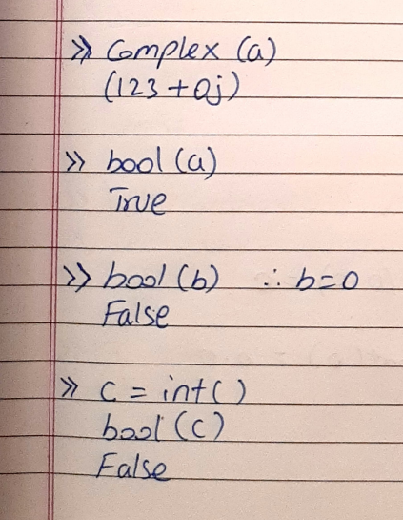
TYPE CASTING

Slide 206
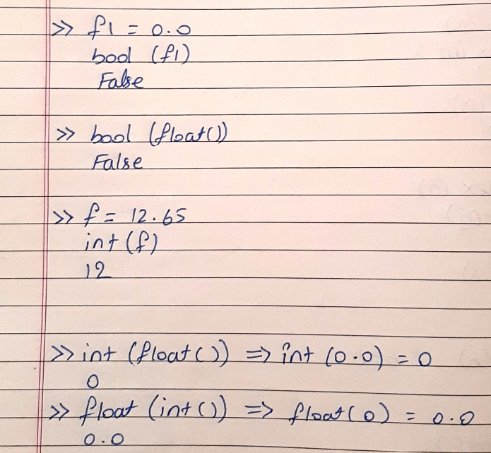
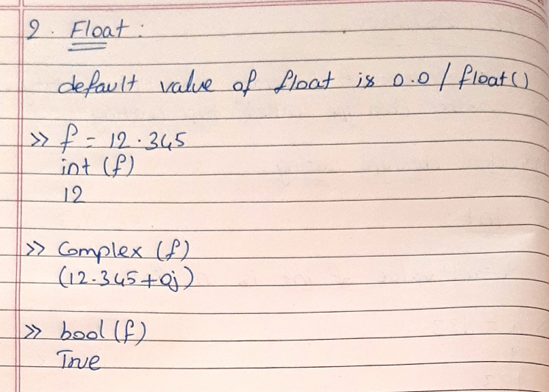

Slide 207
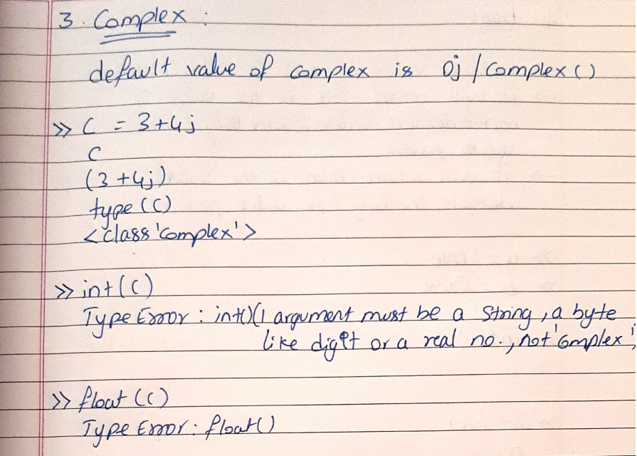
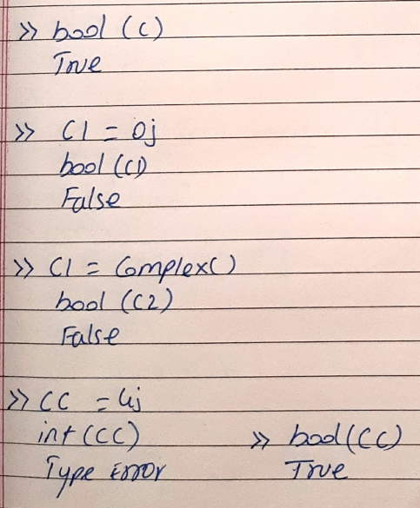

Slide 208
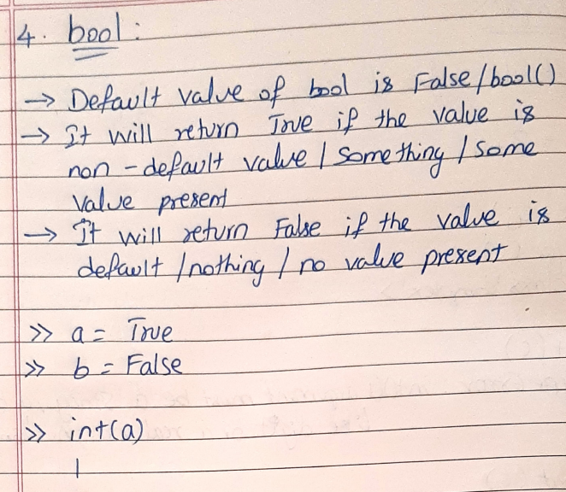
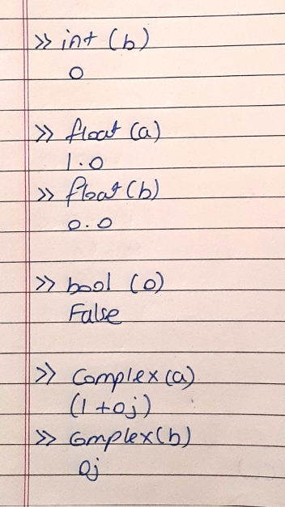

Slide 209
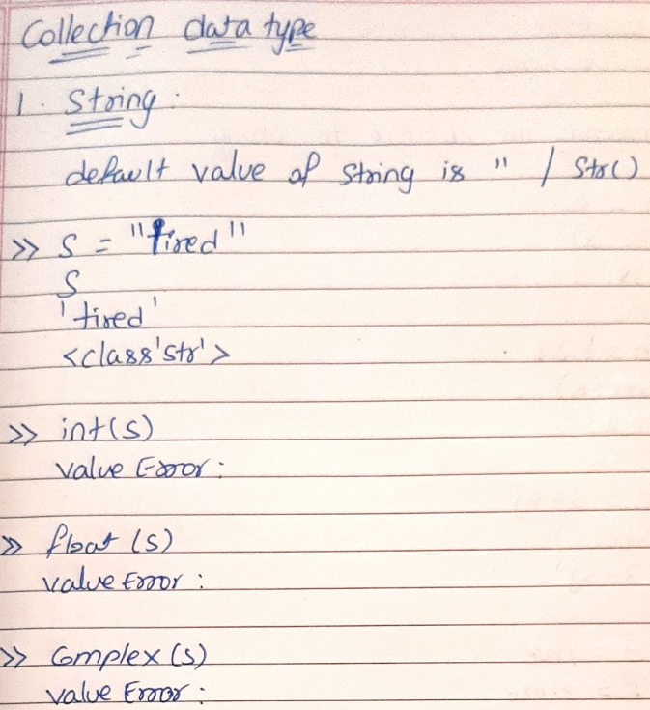
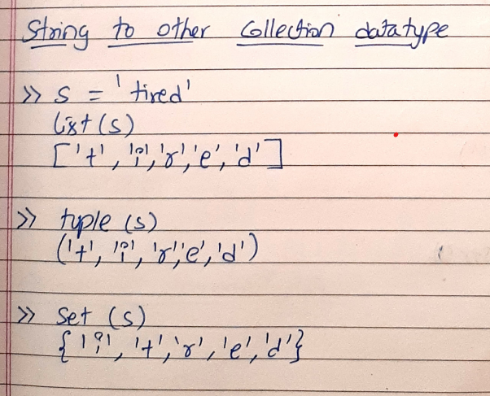
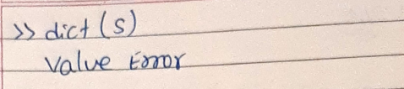

Slide 210
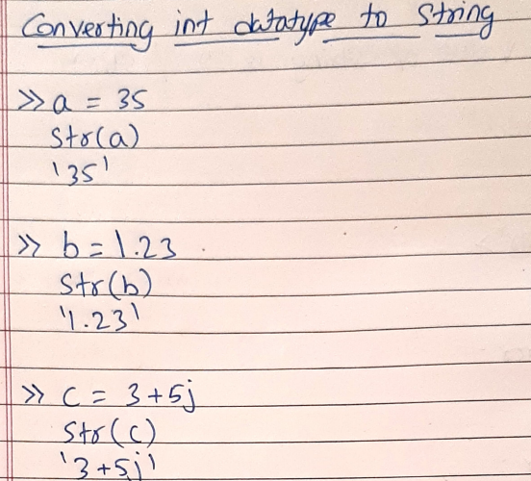
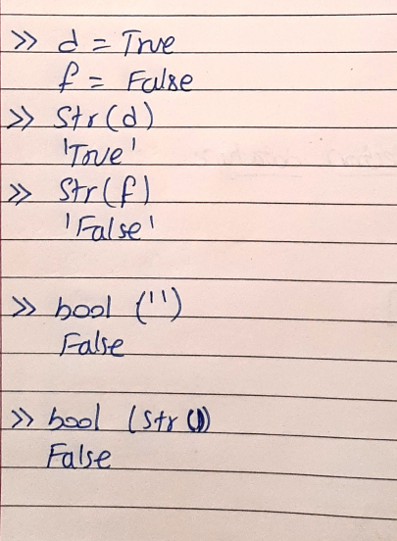

Slide 211
Presentation 25 Type casting Collection data type: List(), Tuple(), Set(), Dict()

Slide 212
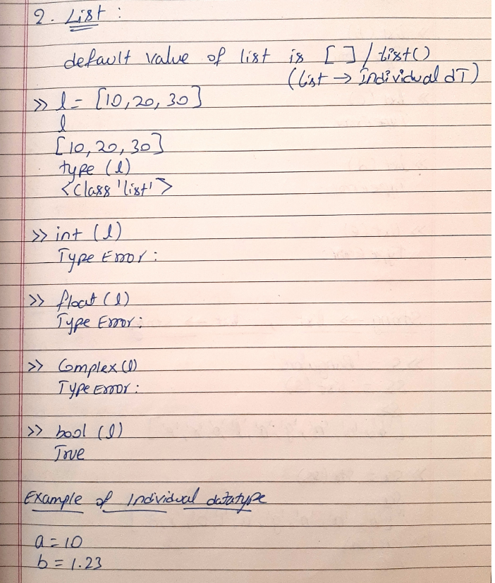
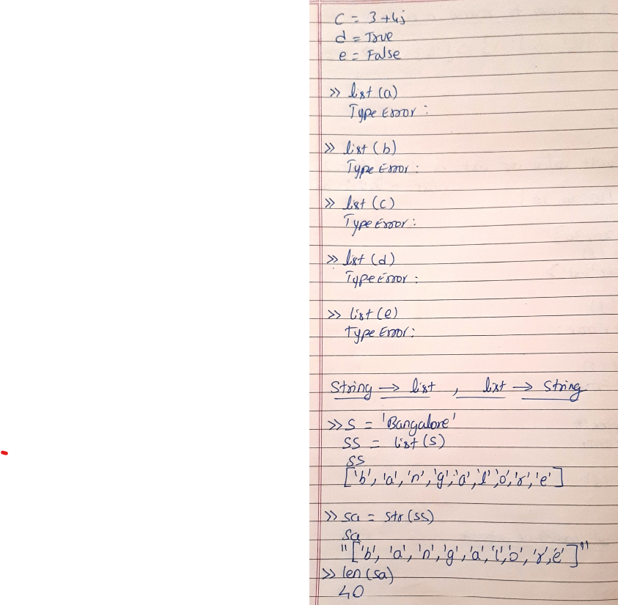

Slide 213
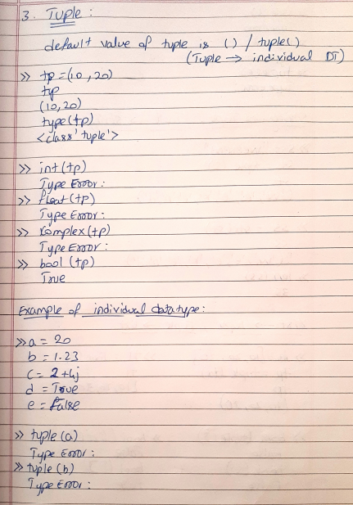
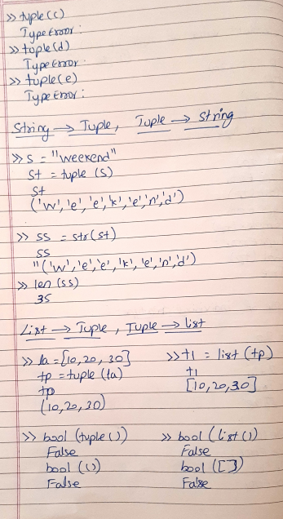

Slide 214
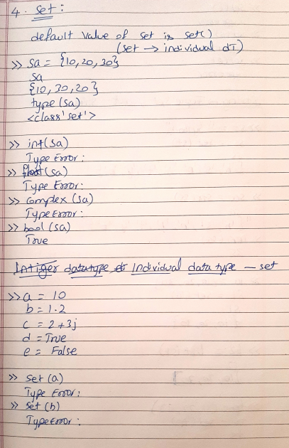
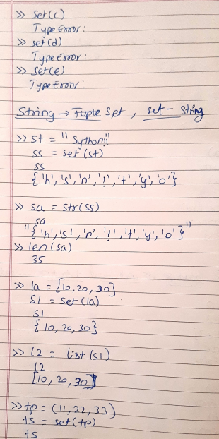
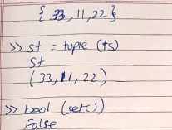

Slide 215
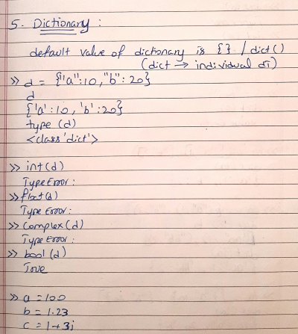
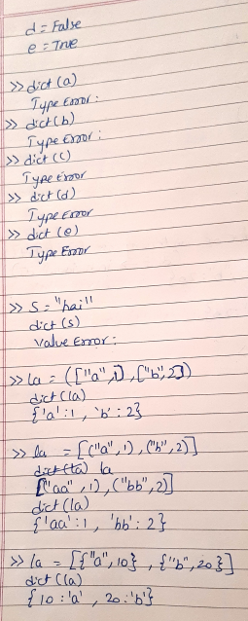
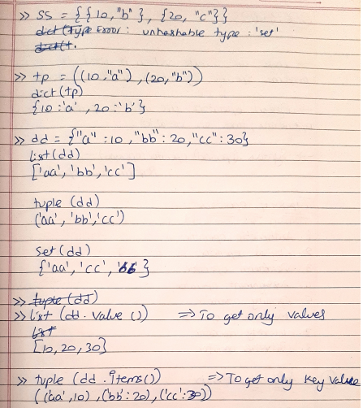

Slide 216
Presentation 26 Operators Arithmetic operator

Slide 217
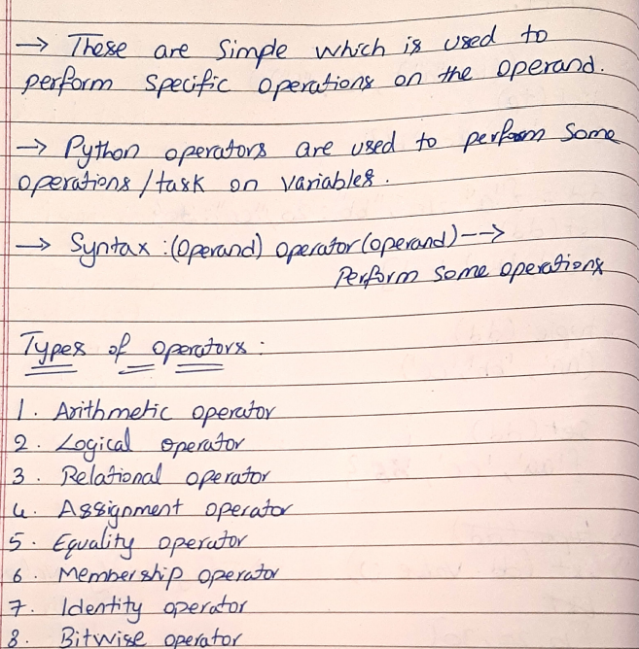
OPERATORS

Slide 218
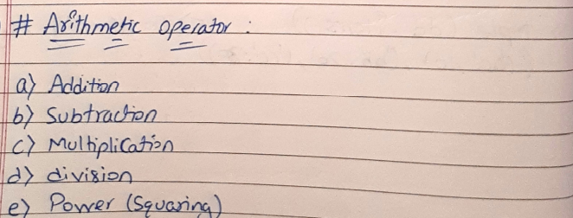

Slide 219
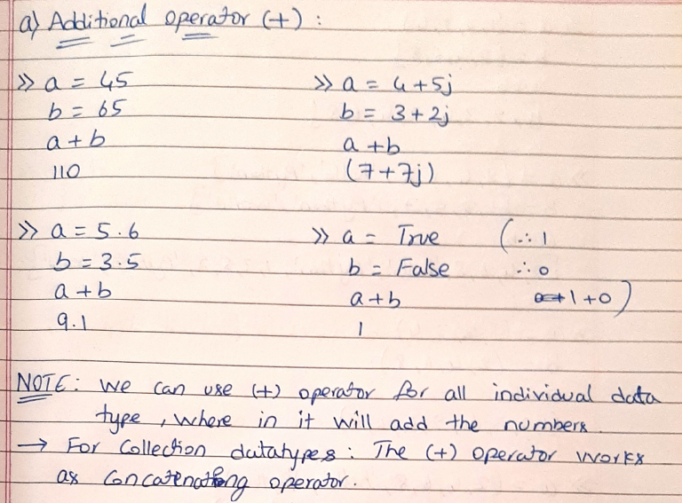

Slide 220
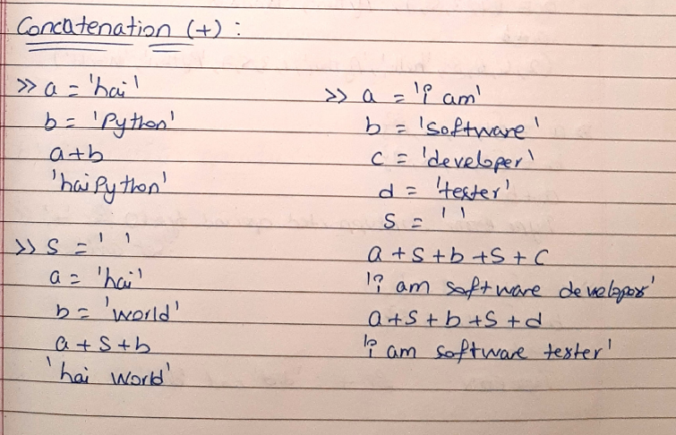

Slide 221
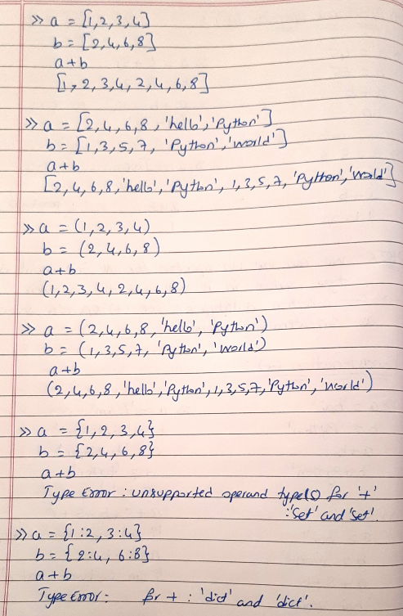
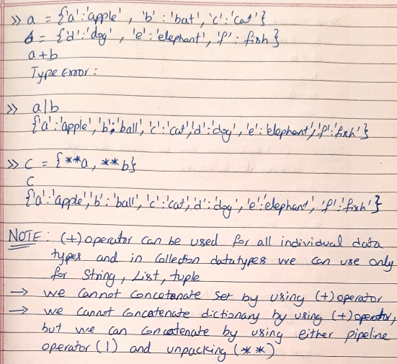

Slide 222
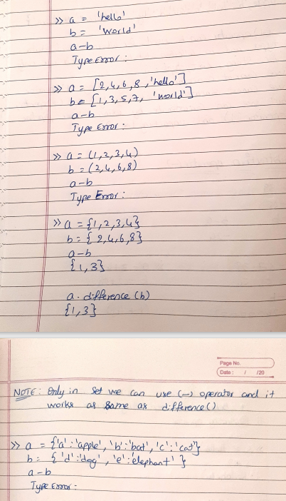
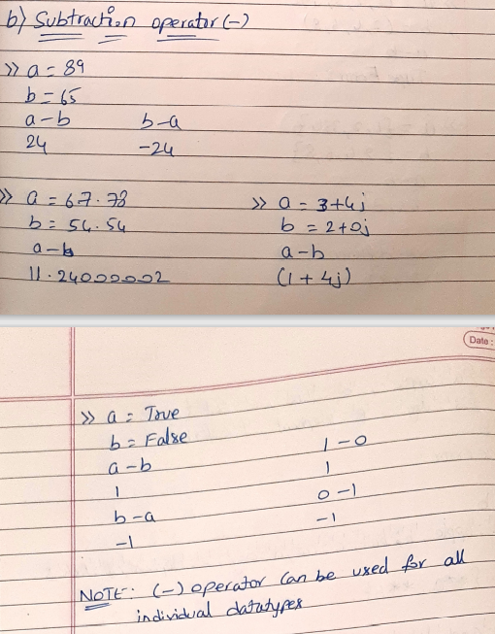

Slide 223
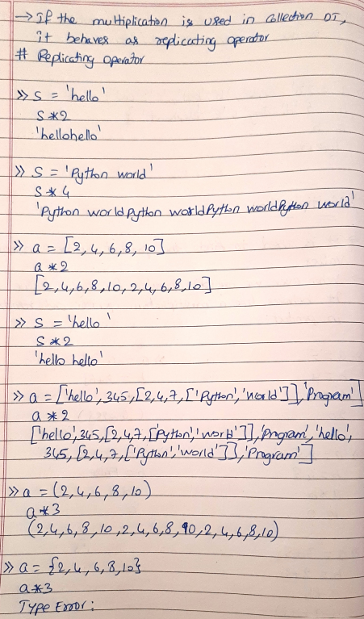
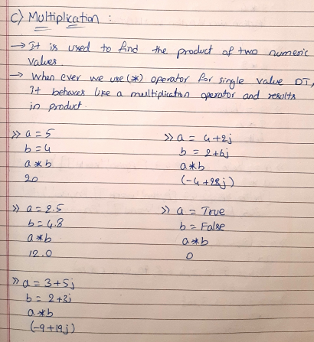
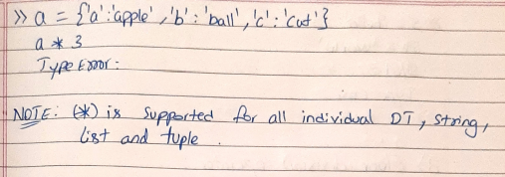

Slide 224
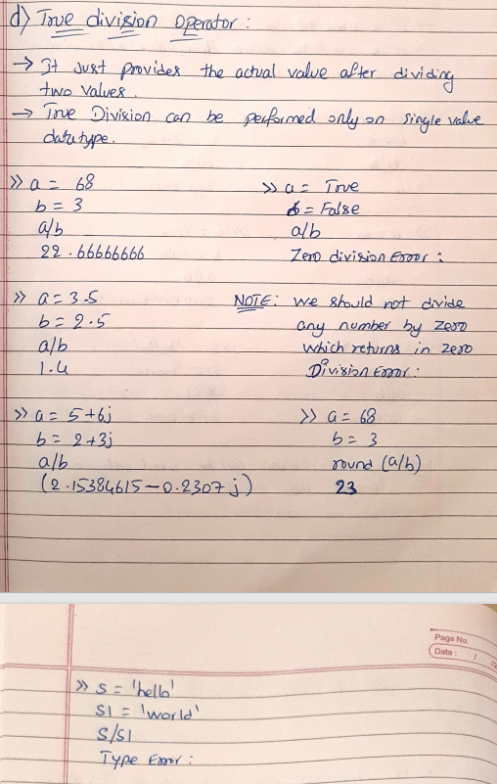

Slide 225
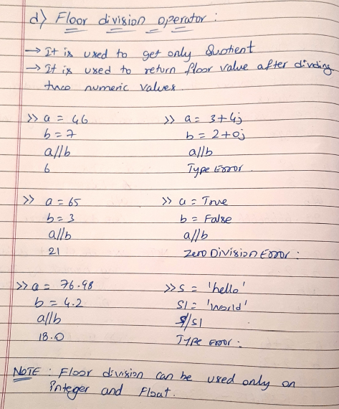
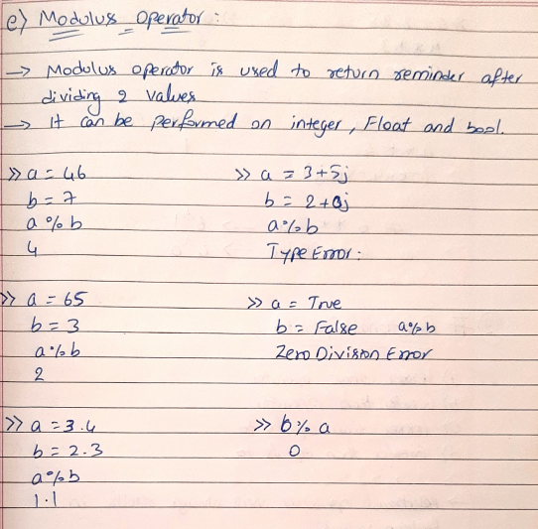

Slide 226


Slide 227
Presentation 27 Operators Relational operator Equality operator

Slide 228


Slide 229



Slide 230



Slide 231




Slide 232


Equality operator

Slide 233
Presentation 28 Operators Logical operator Assignment operator Membership operator Identity operator

Slide 234




Slide 235



Slide 236




Slide 237
Presentation 29 Operators Identity operator Bitwise operator

Slide 238




Slide 239



Slide 240



Slide 241



Slide 242



Slide 243
Presentation 30 Programs

Slide 244


IF STATEMENT

Slide 245


IF ELSE STATEMENT

Slide 246



Slide 247



ELIF STATEMENT

Slide 248



Slide 249



Slide 250


NESTED IF

Slide 251



Slide 253


CONTROL STATEMENT – WHILE LOOP

